Slide 1






Predicting Smoking Status Using Health Indicators
Non-smoker
or
Smoker?
CS 513 A - Knowledge Discovery & Data Mining (Spring 2025 )
Group 4
Himanshu Hemanth Paithane
Vishnu Vardhan Putta
Aditya Yadav

Slide 2
AGENDA
 |  | 1. | Problem Statement & Project Goal
 |  | 2. | Project Workflow
 |  | 3. | Dataset Description
 |  | 4. | Data Cleaning & Exploratory Data Analysis
 |  | 5. | Model Implementation & Evaluation
 |  | 6. | Model Comparison & Conclusion
 |  | 7. | Future Work
 |  | 8. | References

Slide 3
PROBLEM STATEMENT & PROJECT GOAL
Problem Statement:
Smoking contributes to numerous diseases including cancer, cardiovascular diseases, and respiratory disorders
Self-reported smoking status is often unreliable due to social stigma and personal biases
Healthcare providers need objective methods to identify potential smokers for appropriate interventions
Early detection of smoking habits can significantly improve targeted interventions and reduce health risks
Biological indicators and health metrics may reveal smoking habits even when not self-reported
Project Goal:
Develop classification models to accurately predict smoking status based on health indicators
Identify the most predictive biological signals of smoking
Determine the minimum set of health indicators needed for reliable prediction
Compare multiple machine learning approaches to identify optimal models for different use cases
Real-World Applications:
Healthcare screening to identify potential smokers who don't disclose their habit
Insurance risk assessment for more accurate premium calculations
Public health research to study smoking prevalence and effects
Preventive care and targeted smoking cessation interventions
Evidence-based policy development for tobacco control

Slide 4


PROJECT WORKFLOW
Problem Definition
Data Cleaning & Pre-processing
Handling Duplicates and Outliers
Feature encoding
Feature engineering
Exploratory Data Analysis
Correlation Analysis
Feature Importance
Data Acquisition
Feature Selection
Full feature set vs Reduced Feature set
Model Evaluation & Comparison
Performance metrics
Feature set comparison
Model Selection
7 different classification algorithms
Conclusion & Future Work
Model Training

Slide 5
DATASET DESCRIPTION
Dataset Overview:
Source: Kaggle - Body Signal of Smoking Dataset from health screening centers
URL: https://www.kaggle.com/datasets/kukuroo3/body-signal-of-smoking/data
Original Size: 55,692 records with 27 features
After cleaning: 44,084 records (removed duplicates and outliers)
Kaggle Usability Score: 7.06
Objective: Determine smoking status through biological signals and health indicators
Target Variable: "smoking" (Binary: 0 = Non-smoker, 1 = Smoker)
Feature Categories:
Demographics: gender, age, height, weight, waist circumference
Vital Signs: blood pressure (systolic, diastolic), fasting blood sugar
Blood Tests: cholesterol (total, HDL, LDL), triglycerides, hemoglobin
Liver Function: AST, ALT, GTP (liver enzymes)
Sensory Tests: eyesight (left/right), hearing (left/right)
Other Health Indicators: dental caries, tartar, urine protein, serum creatinine
Class Distribution:
63.3% non-smokers (27,972 records)
36.7% smokers (16,112 records)
Moderate class imbalance requiring appropriate evaluation metrics

Slide 6
DATA CLEANING & PREPROCESSING
Initial Data Assessment:
55,692 records with 27 features
No missing values (all fields complete)
11,140 duplicate records identified and removed
Renamed columns to snake_case format for coding consistency
Removed unnecessary features:
ID column (just an index identifier)
'oral' column (constant value across all records)
Categorical Variable Encoding:
Gender: F → 0, M → 1
Tartar: Y → 1, N → 0
Hearing status: Values standardized as 1 = normal, 2 = abnormal
Data Quality Assessment:
Examined feature distributions and identified potential outliers
Checked for class imbalance (63.3% vs 36.7%)
Verified data types and consistency
Final Dataset:
After cleaning: 44,084 records with 25 features
Created two datasets for model comparison:
Full feature set: All 29 features (including engineered features)
Reduced feature set: Top 15 most important features

Slide 7
OUTLIER DETECTION AND REMOVAL
Outlier Detection Method:
Used Interquartile Range (IQR) method for robust outlier identification
For each numerical feature:
Calculated Q1 (25th percentile) and Q3 (75th percentile)
Defined outlier boundary as Q1-1.5IQR and Q3+1.5IQR
Flagged values outside this range as potential outliers
Conservative approach: only removed rows that were outliers in 5+ columns
This preserved legitimate variability while removing truly anomalous records
Results:
468 outliers identified and removed (1.05% of data)
Final dataset: 44,084 records
Particularly affected features: triglyceride, ALT, AST, GTP (liver enzymes)
Why IQR Method?
Resistant to extreme values (doesn't rely on mean)
Uses quartiles for robust representation of data distribution
1.5 * IQR threshold is statistically sound and widely accepted
Preserves natural biological variability while removing true anomalies

Slide 8
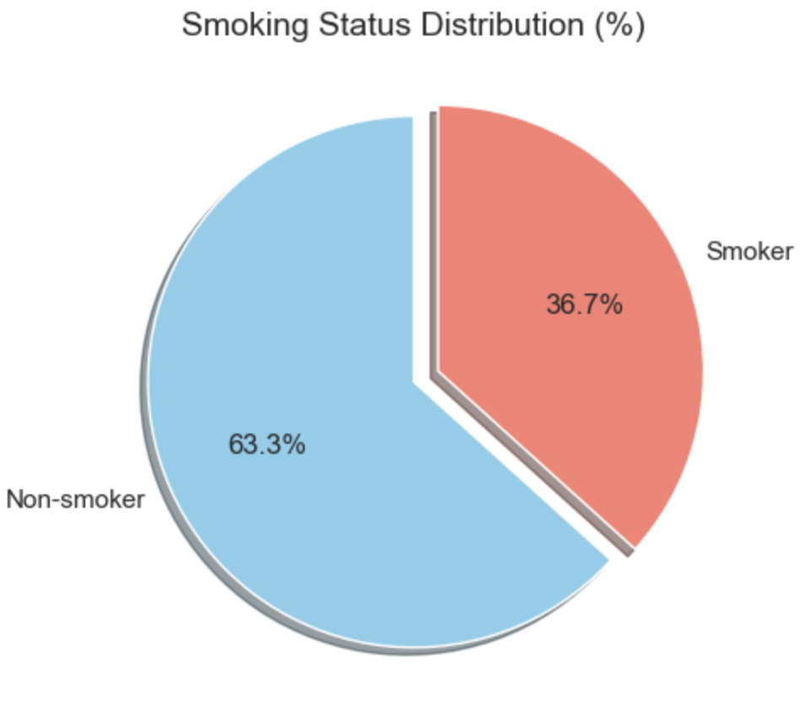
TARGET VARIABLE AND CLASS DISTRIBUTION
Target Variable Analysis:
Binary classification: Smoker (1) vs Non-smoker (0)
After cleaning: 63.3% non-smokers (27,972), 36.7% smokers (16,112)
Class ratios preserved in train/test splits using stratification
Class Imbalance Assessment:
63:37 ratio represents moderate imbalance
Not severe enough to require advanced resampling techniques
Comparable to real-world smoking prevalence in many populations
According to class imbalance literature:
60:40 or 70:30 is mild imbalance
80:20 is moderate imbalance
90:10 or more extreme is severe imbalance
Evaluation Strategy:
80% training set, 20% test set
Stratified sampling to maintain class distribution
Multiple metrics beyond accuracy:
Precision, Recall, F1-score, ROC-AUC

Slide 9
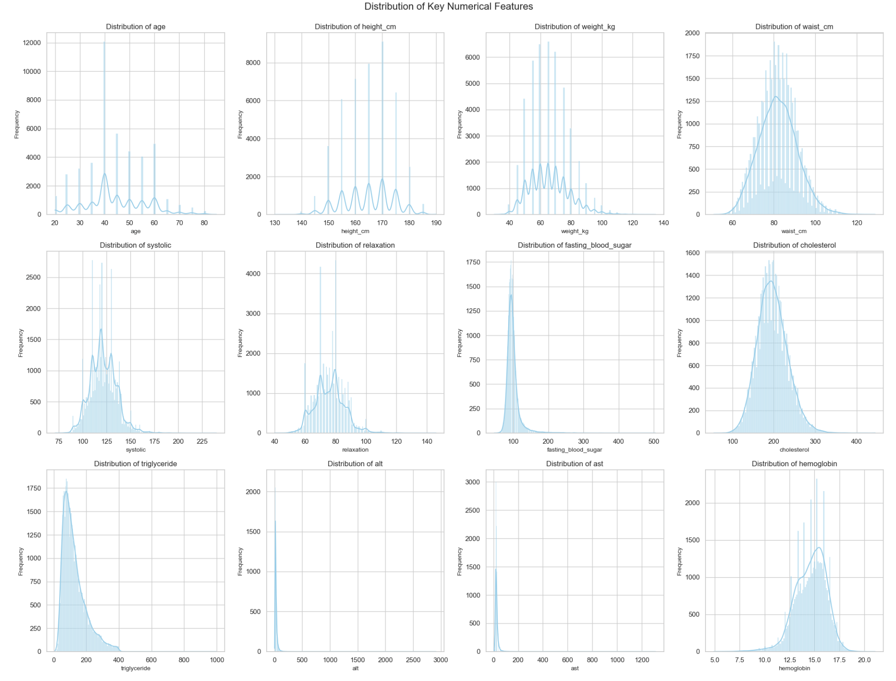
NUMERICAL FEATURE DISTRIBUTIONS
Numerical Feature Histograms:
Explored distributions of key health indicators to understand data characteristics
Most features show approximately normal distributions with varying degrees of skewness
Some features display clear bimodal patterns related to gender differences
Key Observations:
Height and hemoglobin show bimodal distributions (gender effect)
Liver enzymes (AST, ALT) are right-skewed with long tails
Triglyceride levels show significant right skew with outliers
Blood pressure and cholesterol metrics have approximately normal distributions
Age distribution reflects sampling across different age groups
Implications for Modeling:
Skewed distributions may affect some models more than others
Bimodal distributions highlight the importance of gender as a factor
Range and scale differences justify normalization for distance-based models
Outlier handling was critical for heavily skewed features

Slide 10
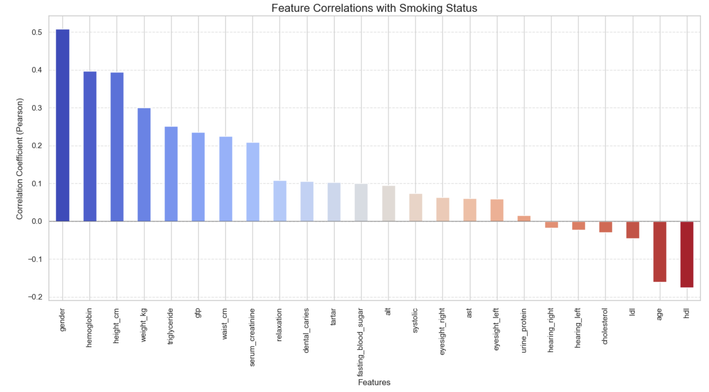
CORRELATION ANALYSIS
Top Positive Correlations:
Gender (0.508) - Significantly higher in males
Hemoglobin (0.397) - Higher levels in smokers (CO effect)
Height (0.394) - Taller individuals (gender-related)
Weight (0.299) - Heavier individuals
Triglyceride (0.251) - Higher levels in smokers
GTP (0.247) - Elevated liver enzyme in smokers
Top Negative Correlations:
HDL (-0.176) - Lower "good" cholesterol in smokers
Age (-0.161) - Younger individuals more likely smokers
LDL (-0.045) - Negative correlation with "bad" cholesterol
Cholesterol (-0.030) - Slight negative correlation with total cholesterol
Hearing status (-0.024) - Minor correlation with hearing
Physiological Significance:
Smoking increases carbon monoxide in blood, leading to compensatory increase in hemoglobin
Smoking negatively impacts HDL (good cholesterol) levels
Smoking affects liver function (GTP, ALT)
Strong gender effect suggests different smoking patterns between males and females
Correlations align with established medical knowledge about smoking effects

Slide 11
FEATURE ENGINEERING
New Features Created:
BMI (Body Mass Index) = weight_kg / (height_cm/100)²
Standard health metric used in medical assessment
Blood Pressure Ratio = systolic / relaxation
Indicator of cardiovascular health
Cholesterol Ratio = total_cholesterol / hdl
Key predictor of cardiovascular risk
LDL/HDL Ratio = ldl / hdl
More specific lipid balance indicator
Hypertension (binary) = 1 if (systolic ≥ 140 OR relaxation ≥ 90)
Clinical diagnosis indicator
Correlation with Smoking:
Cholesterol Ratio: 0.145 (strongest new feature)
LDL/HDL Ratio: 0.071
BMI: 0.104
BP Ratio: -0.061
Hypertension: 0.010
Clinical Relevance:
Engineered features capture important health relationships
Cholesterol ratio is widely used in cardiovascular risk assessment
BMI provides standardized weight-to-height relationship
BP ratio reflects arterial stiffness and cardiovascular function
These metrics are routinely used in clinical practice

Slide 12
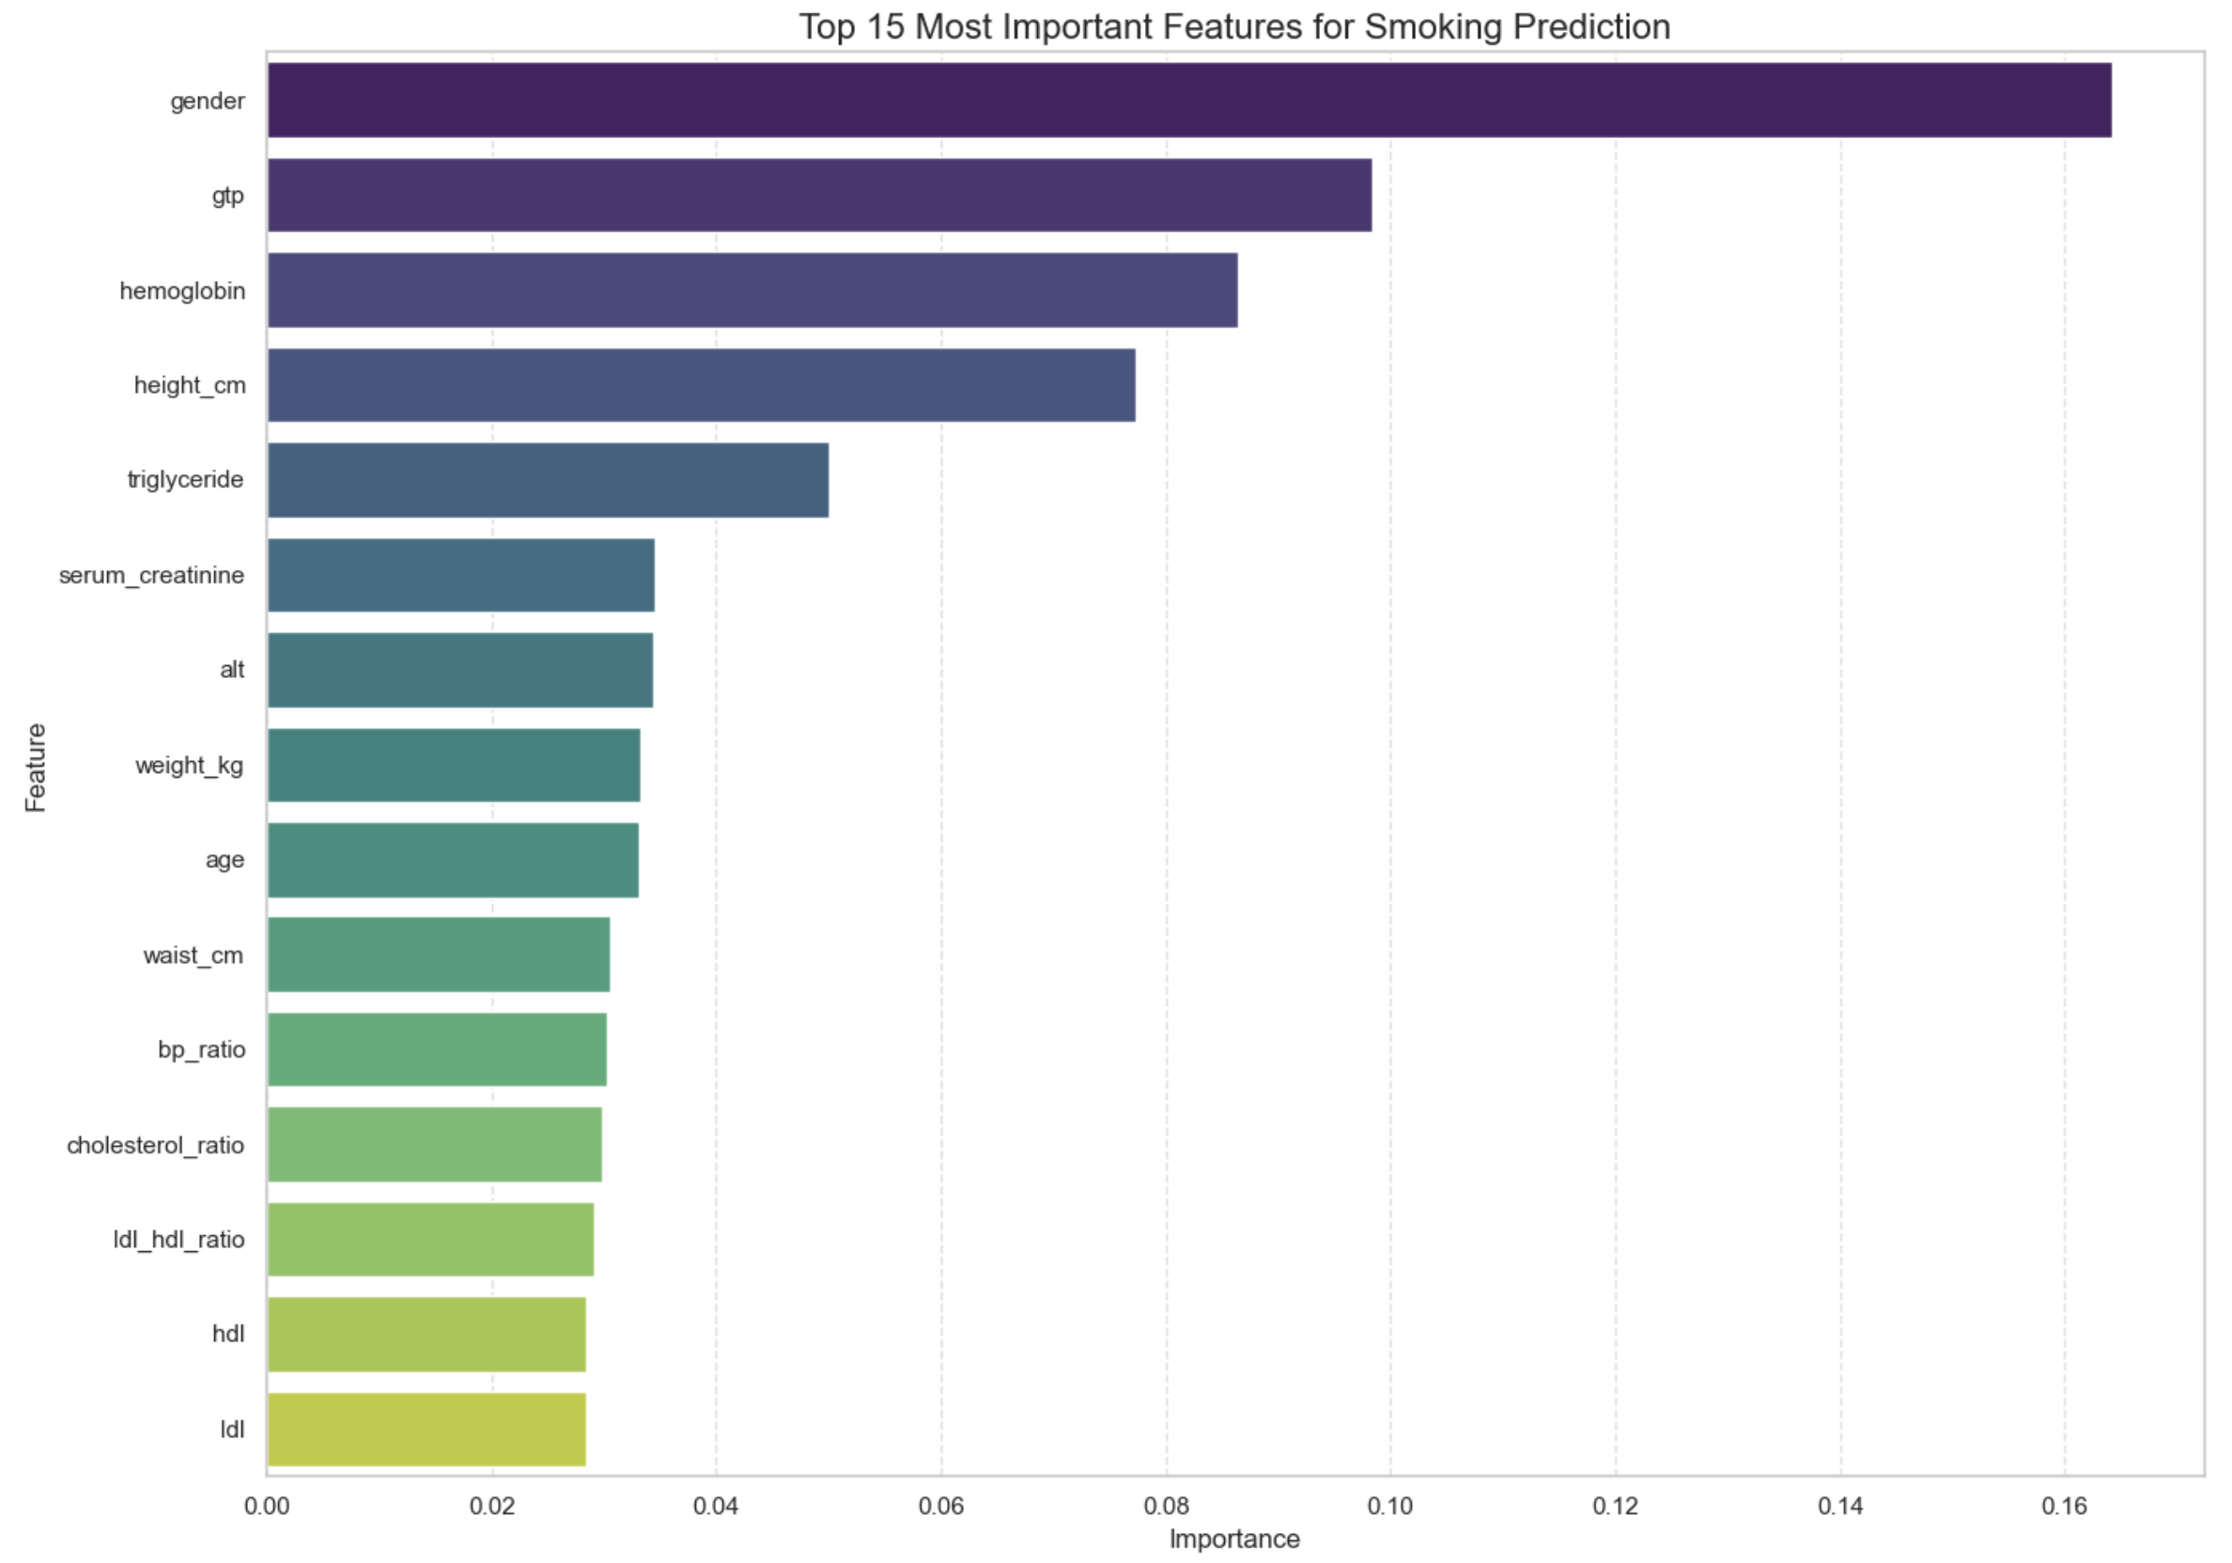
FEATURE IMPORTANCE AND SELECTION
Feature Importance Method:
Used Random Forest for feature ranking
Benefits: Handles non-linear relationships, robust to outliers
100 trees with controlled depth to avoid overfitting
Cross-validated to ensure stability and generalizability
Feature Selection Strategy:
Created reduced dataset with top 15 features
Will compare model performance: full vs. reduced set
Potential benefits of reduced feature set:
Lower data collection costs
Faster computation
Reduced overfitting risk
More interpretable models
Top 15 Important Features:
Gender (0.164)
GTP (0.098)
Hemoglobin (0.086)
Height (0.077)
Triglyceride (0.050)
Serum creatinine (0.035)
ALT (0.034)
Weight (0.033)
Age (0.033)
Waist circumference (0.031)
Blood Pressure ratio (0.030)
Cholesterol ratio (0.029)
LDL/HDL ratio (0.029)
HDL (0.028)
LDL (0.028)

Slide 13
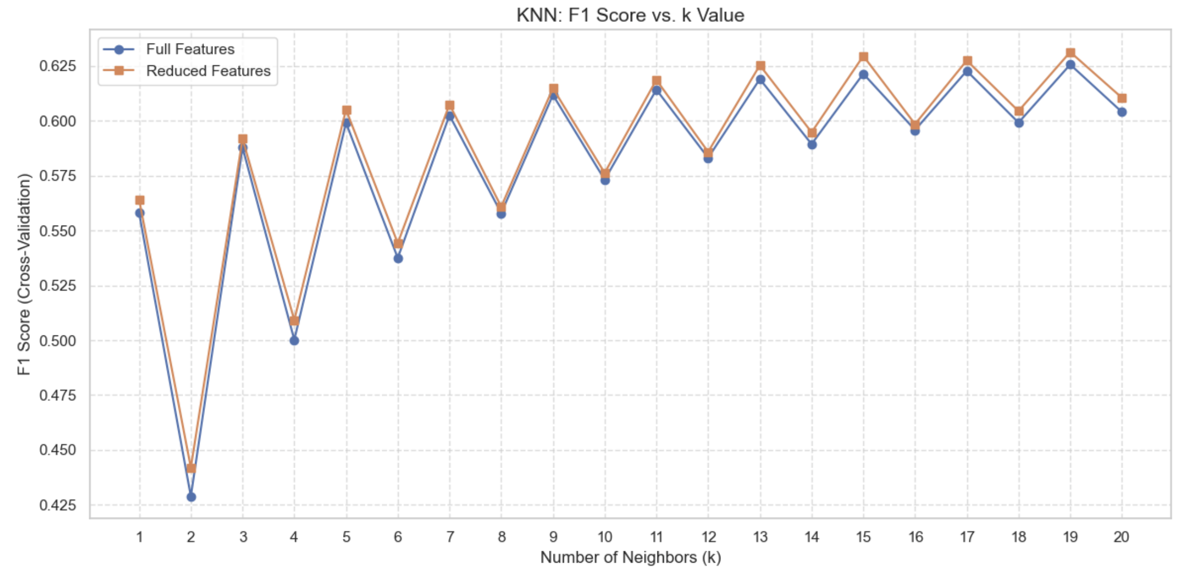
MODEL: KNN
KNN Approach:
K-Nearest Neighbors classifies based on similarity to training examples
Distance-based method requiring careful feature scaling
Applied MinMaxScaler to scale all features to [0,1] range
Euclidean distance used for proximity calculation
Optimization Process:
Tested K values from 1 to 20 using 5-fold cross-validation
Used F1-score as optimization metric to balance precision and recall
Evaluated both full and reduced feature sets
Results:
Optimal K for both datasets: K = 19
Larger K indicates smoother decision boundaries needed
Similar optimal K for both feature sets suggests consistent neighborhood structure
K=19 provides noise resistance while maintaining predictive power

Slide 14
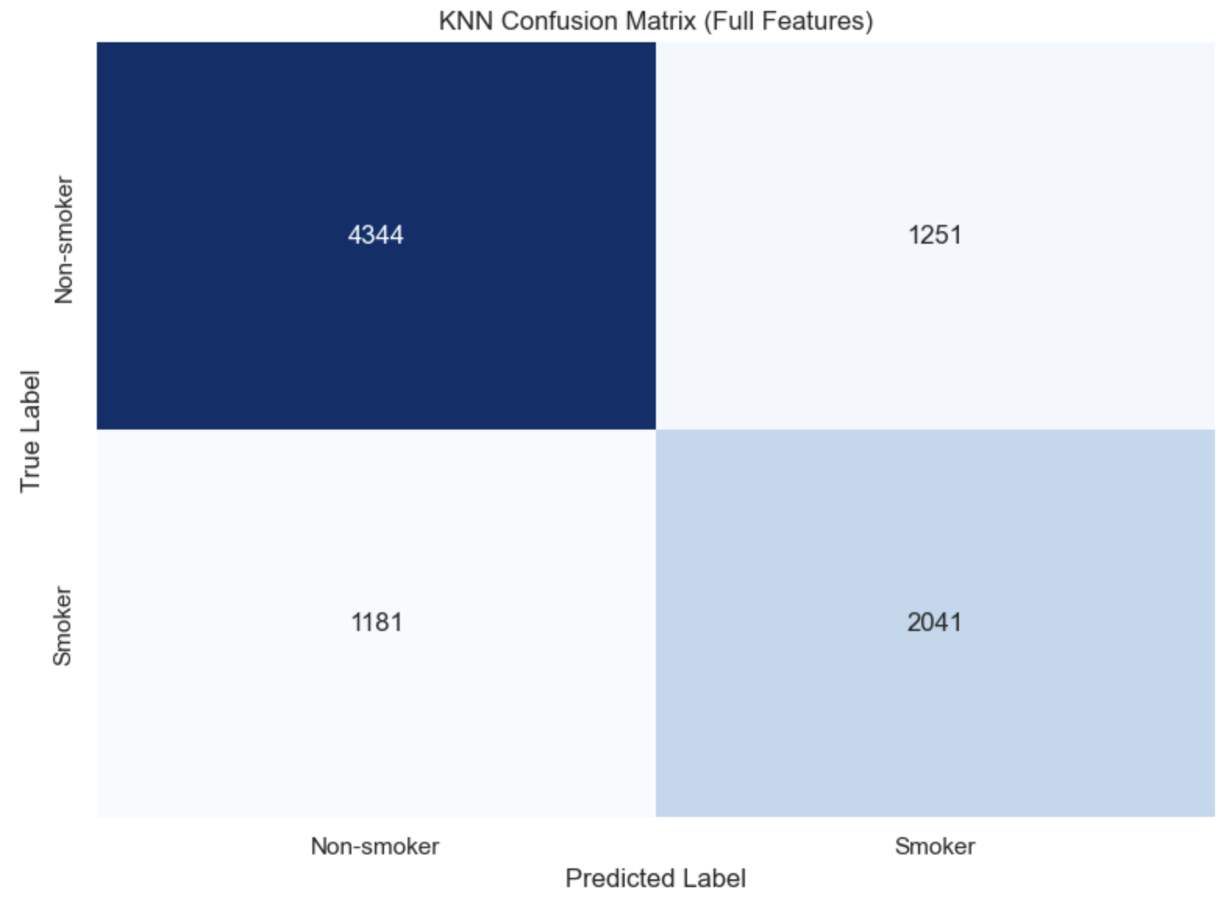
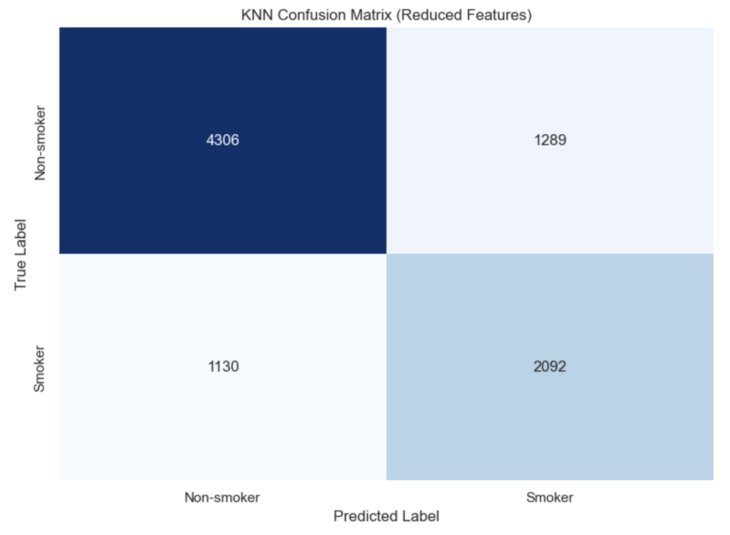
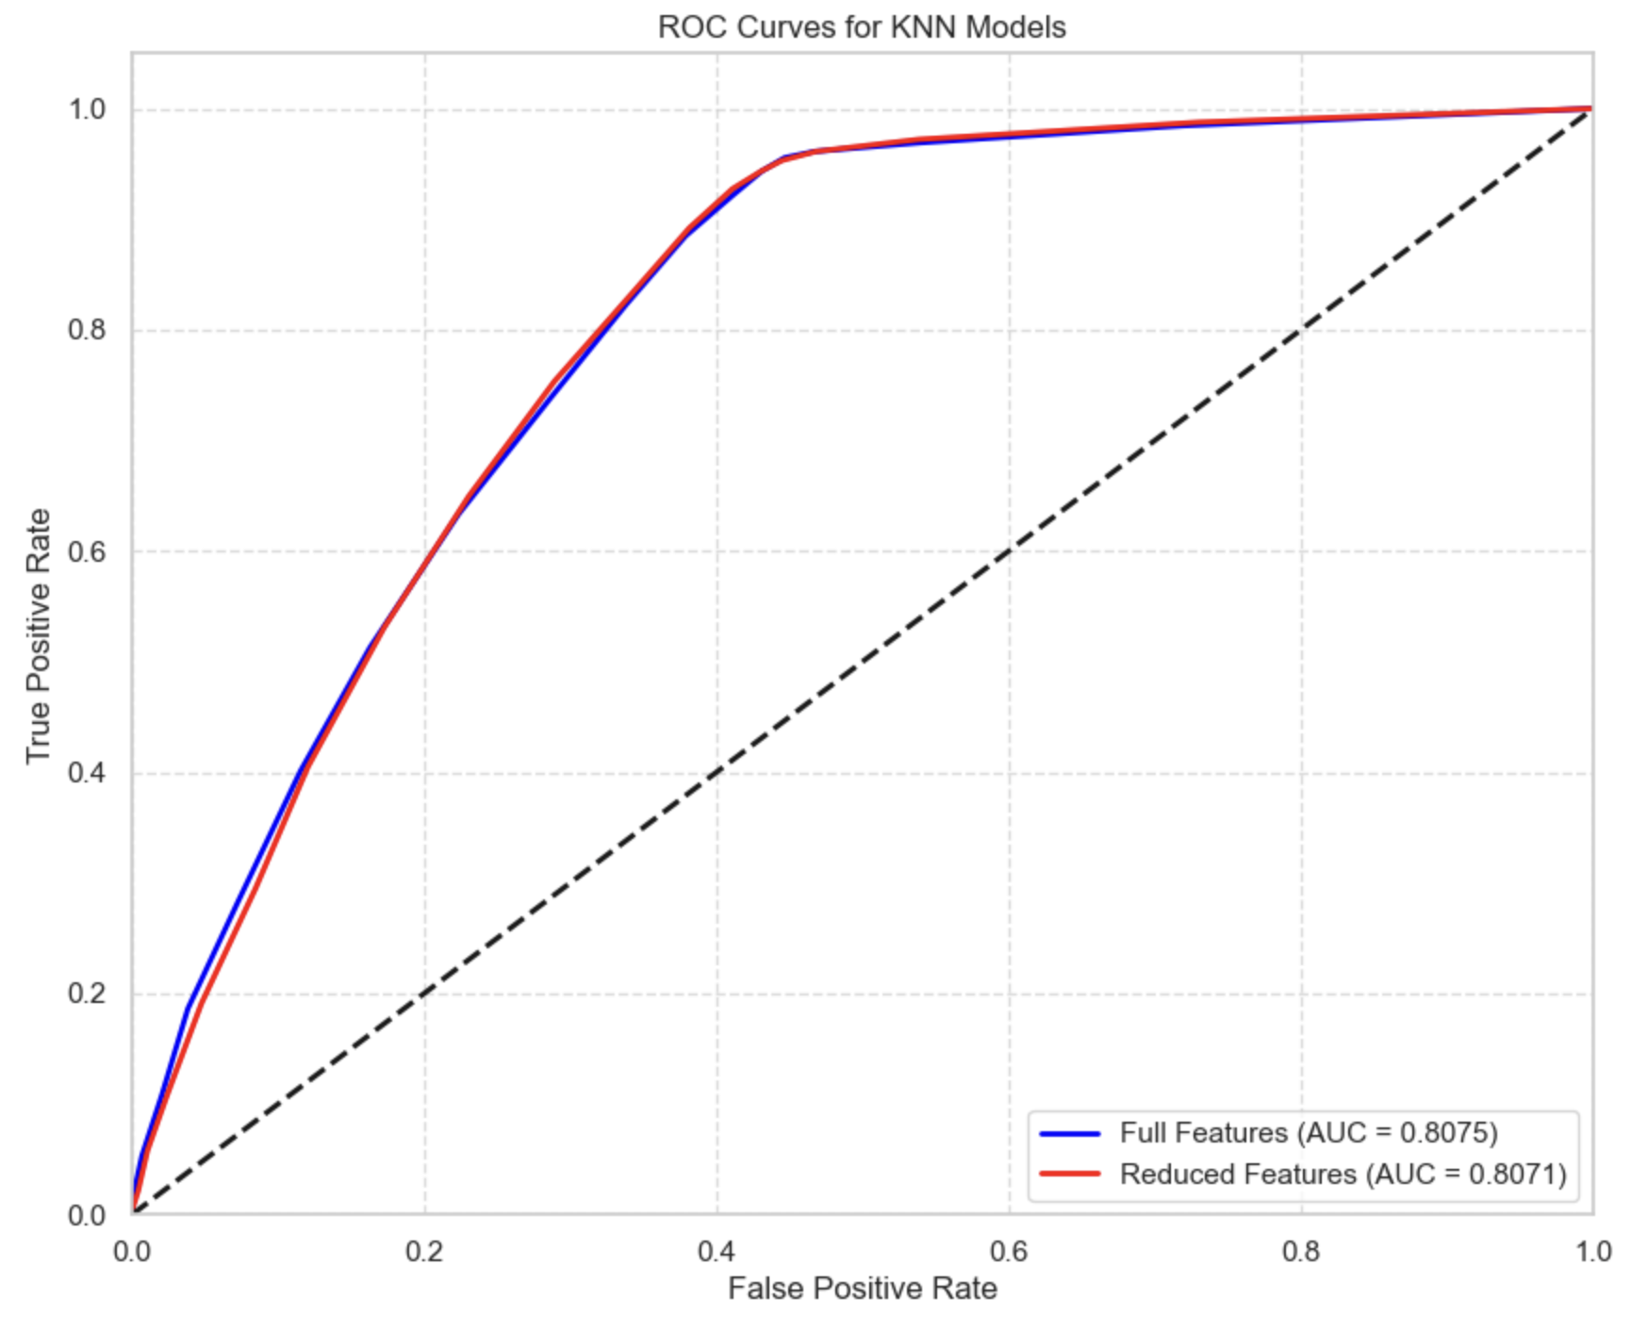
MODEL: KNN
Performance Metrics:
Metric | Full Features | Reduced Features
Accuracy | 0.724 | 0.726
Precision | 0.620 | 0.619
Recall | 0.633 | 0.649
F1 Score | 0.627 | 0.634
ROC AUC | 0.808 | 0.807
Key Observations:
Reduced feature set performs slightly better than full set
Improved recall with reduced features (+1.6%)
Feature reduction simplifies model without performance loss
Good balance between precision and recall
Provides strong baseline with simple, interpretable algorithm
ROC AUC of ~0.81 indicates good discrimination ability

Slide 15
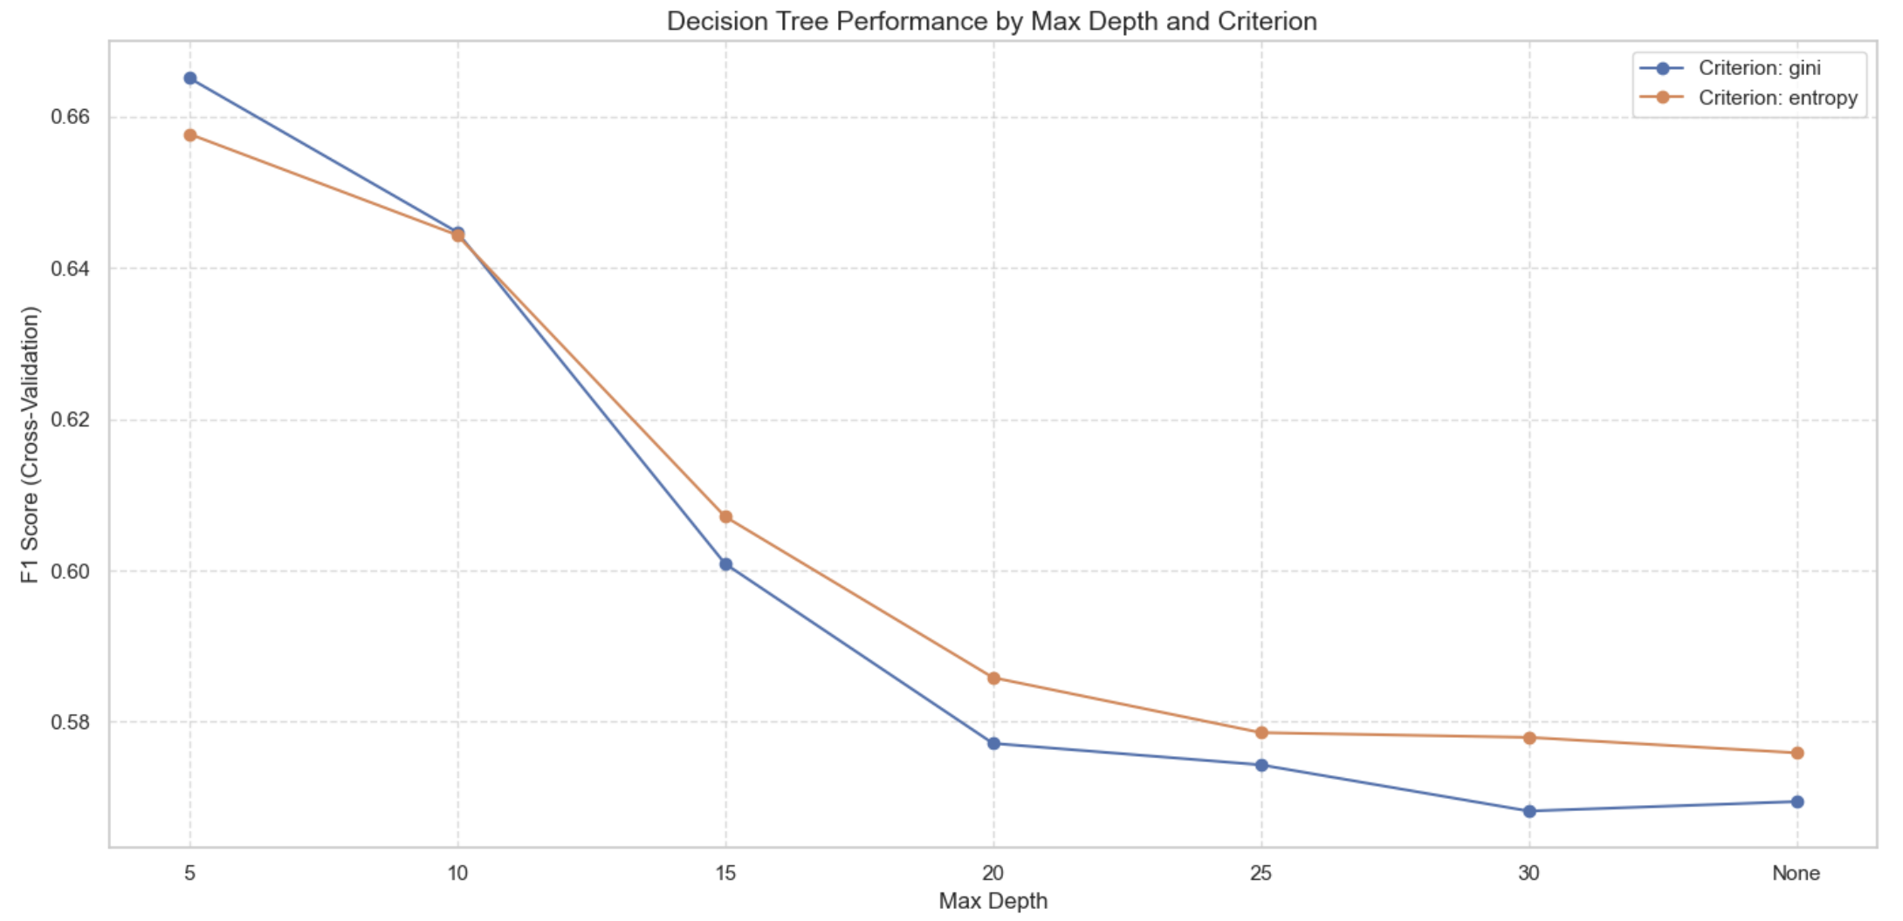
MODEL: DECISION TREE (CART)
CART Implementation:
Classification and Regression Trees (CART) recursively partition data
Creates a flowchart-like structure of binary decisions
No feature scaling required (threshold-based decisions)
Naturally handles both numerical and categorical features
Optimization Approach:
Tested different split criteria:
Gini impurity: Measures probability of misclassification
Entropy: Measures information gain
Explored max_depth values: 5, 10, 15, 20, 25, 30, None
Evaluated 50 different random states for tree initialization
Used cross-validation F1-score for parameter selection
Best Parameters:
Criterion: gini
Max Depth: 5
Random State: 1
Best Cross-Validation F1 Score: 0.67

Slide 16
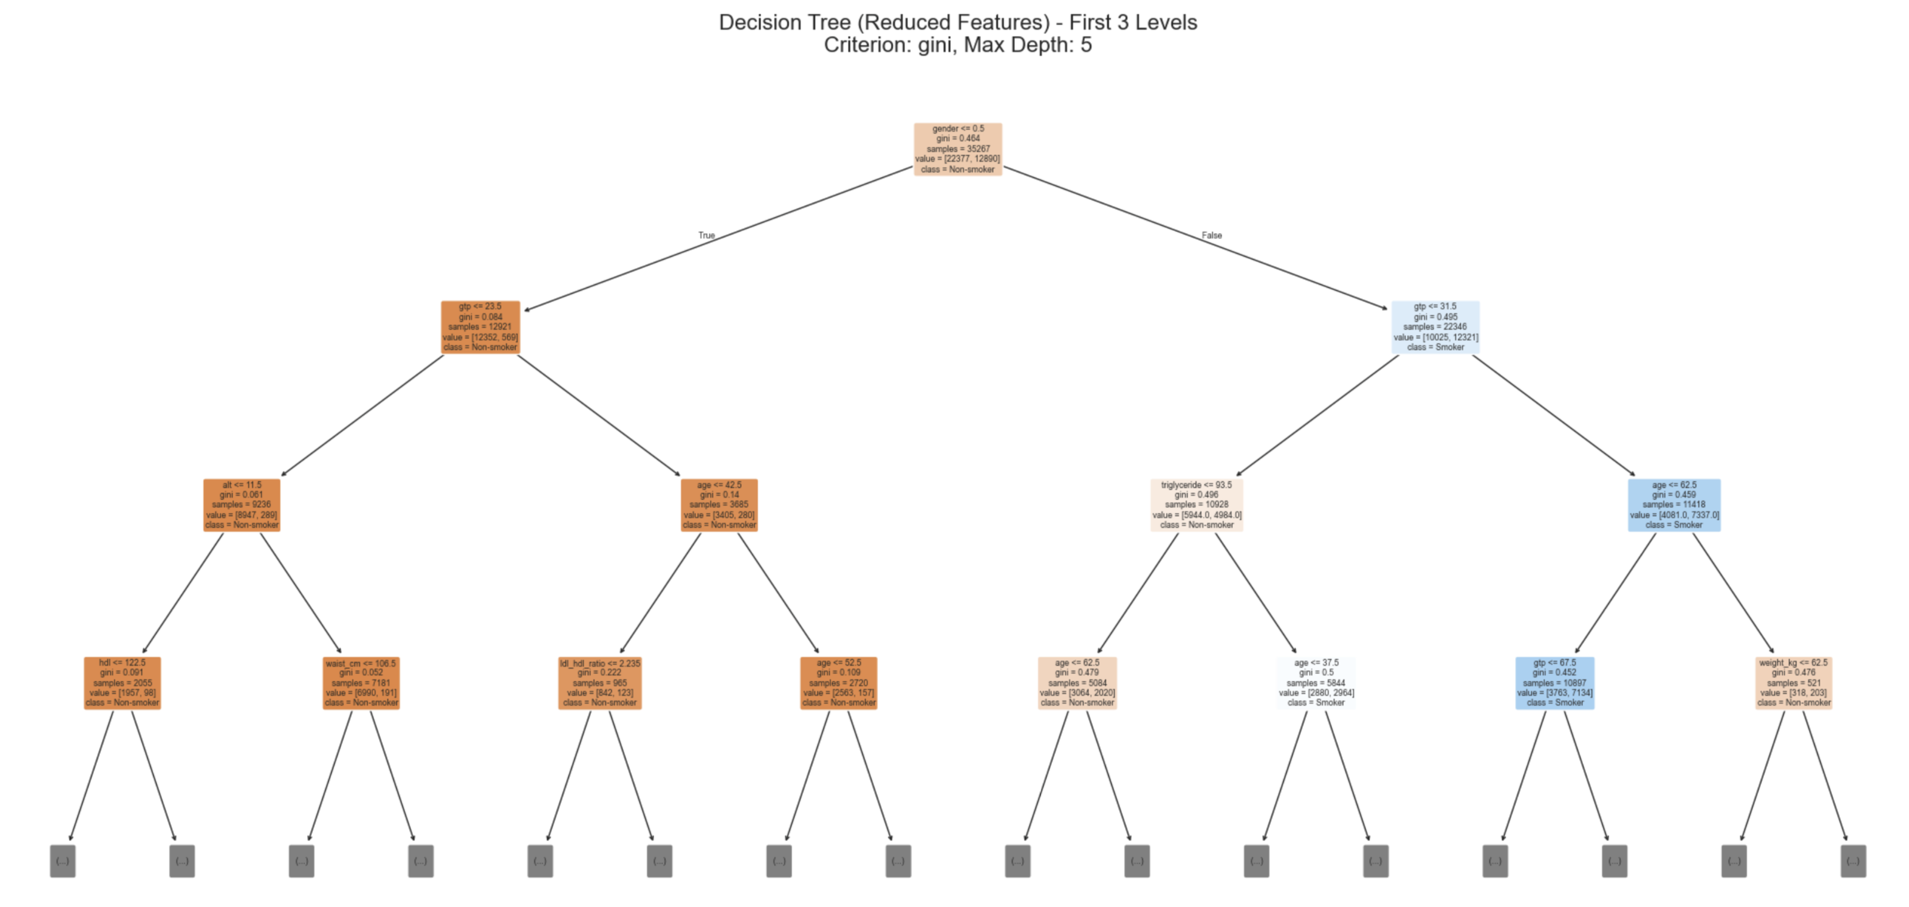
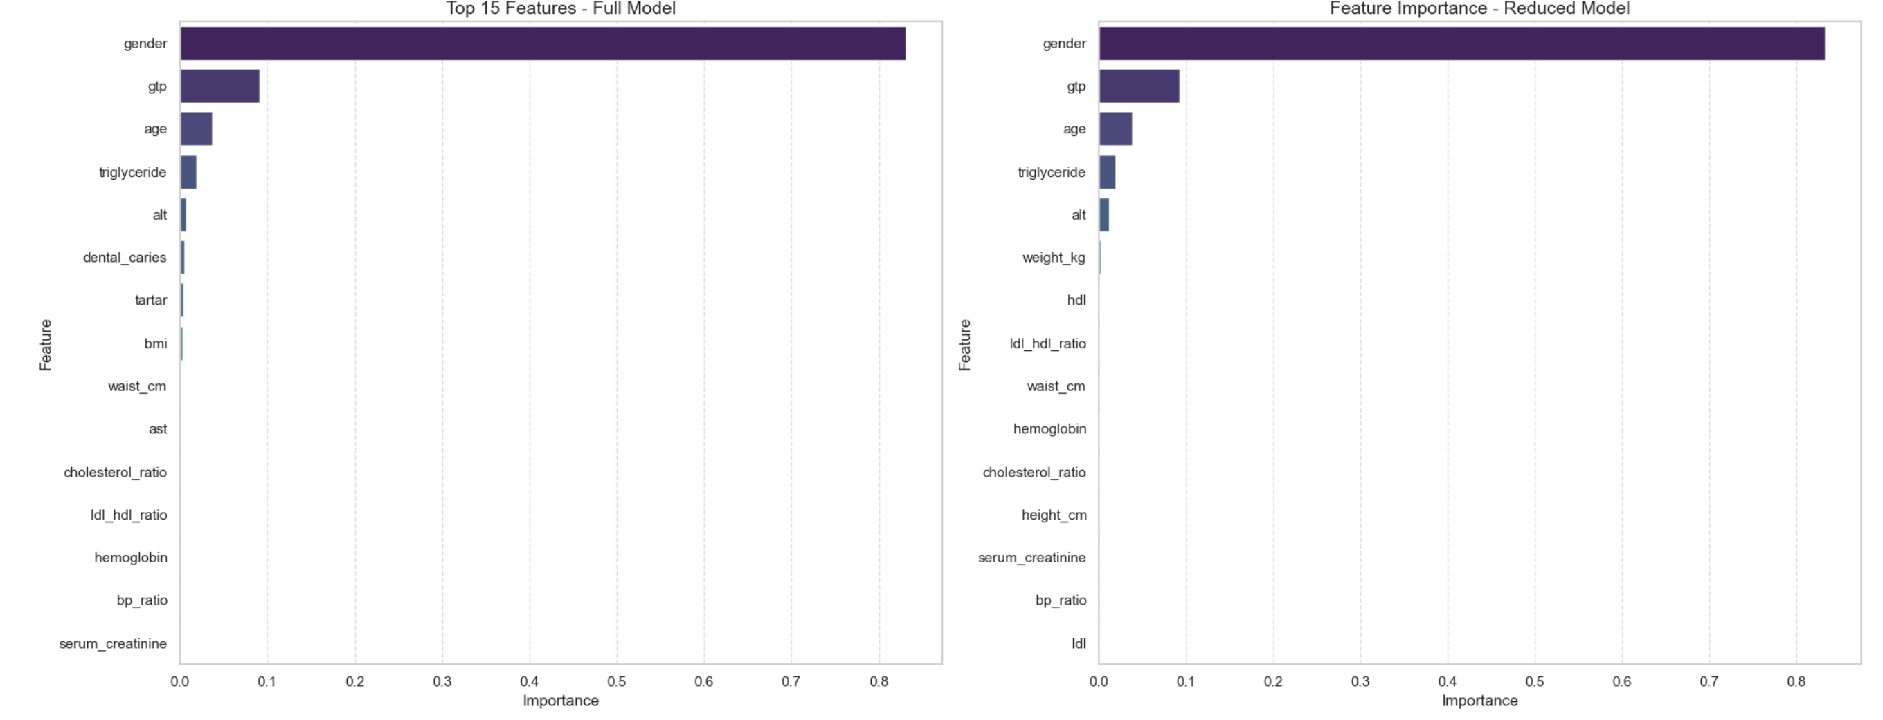
MODEL: DECISION TREE (CART)
Tree Structure Insights:
Root node splits on gender (most discriminative feature)
For males (gender=1):
GTP is the next most important split
Age and hemoglobin form subsequent decision points
For females (gender=0):
Different feature pathway follows
Hemoglobin and triglyceride are key factors
Top Important Features:
Gender (0.83) - Dominates the decision process
GTP (0.09) - Liver enzyme elevated in smokers
Age (0.04) - Age-related smoking patterns
Triglyceride (0.02) - Lipid marker affected by smoking
ALT (0.01) - Liver function indicator

Slide 17
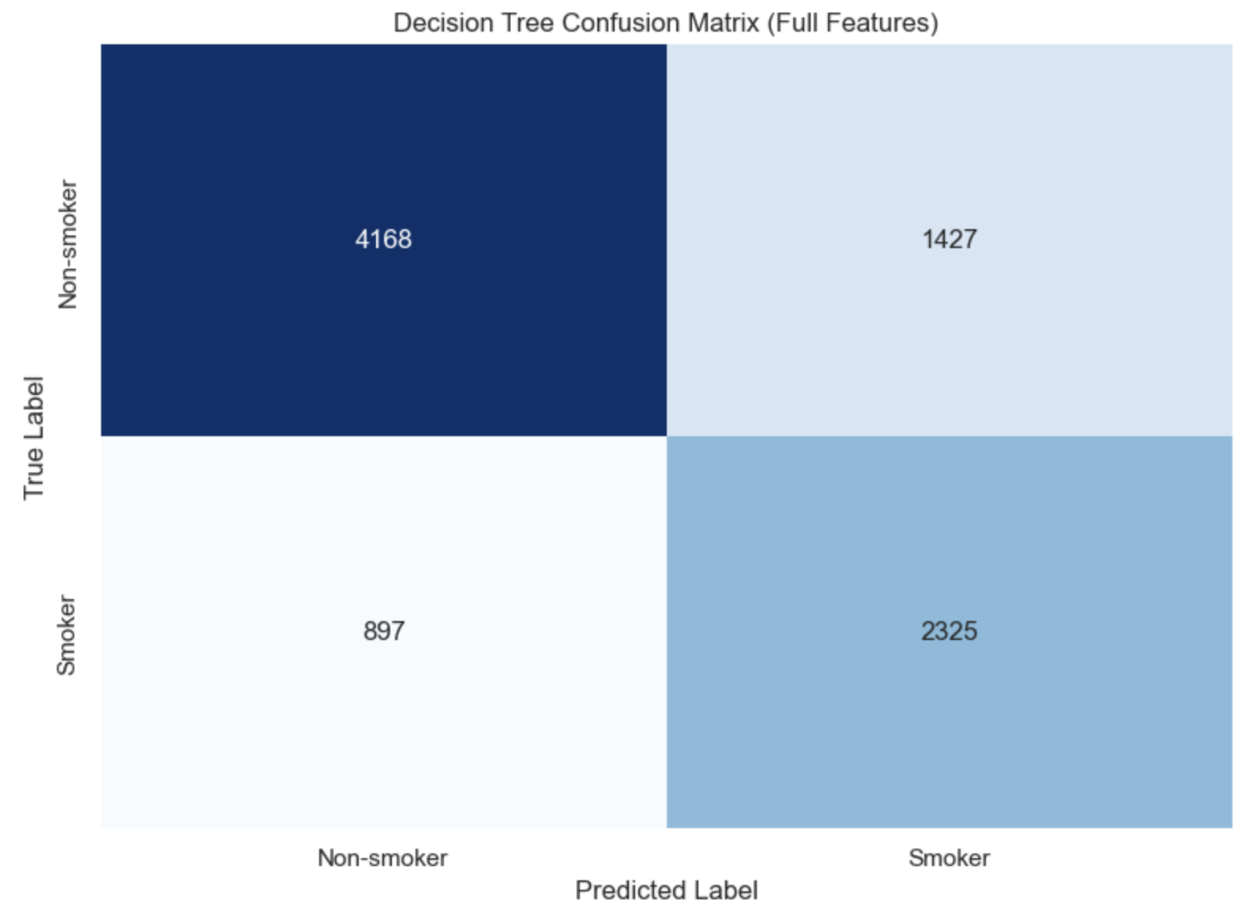
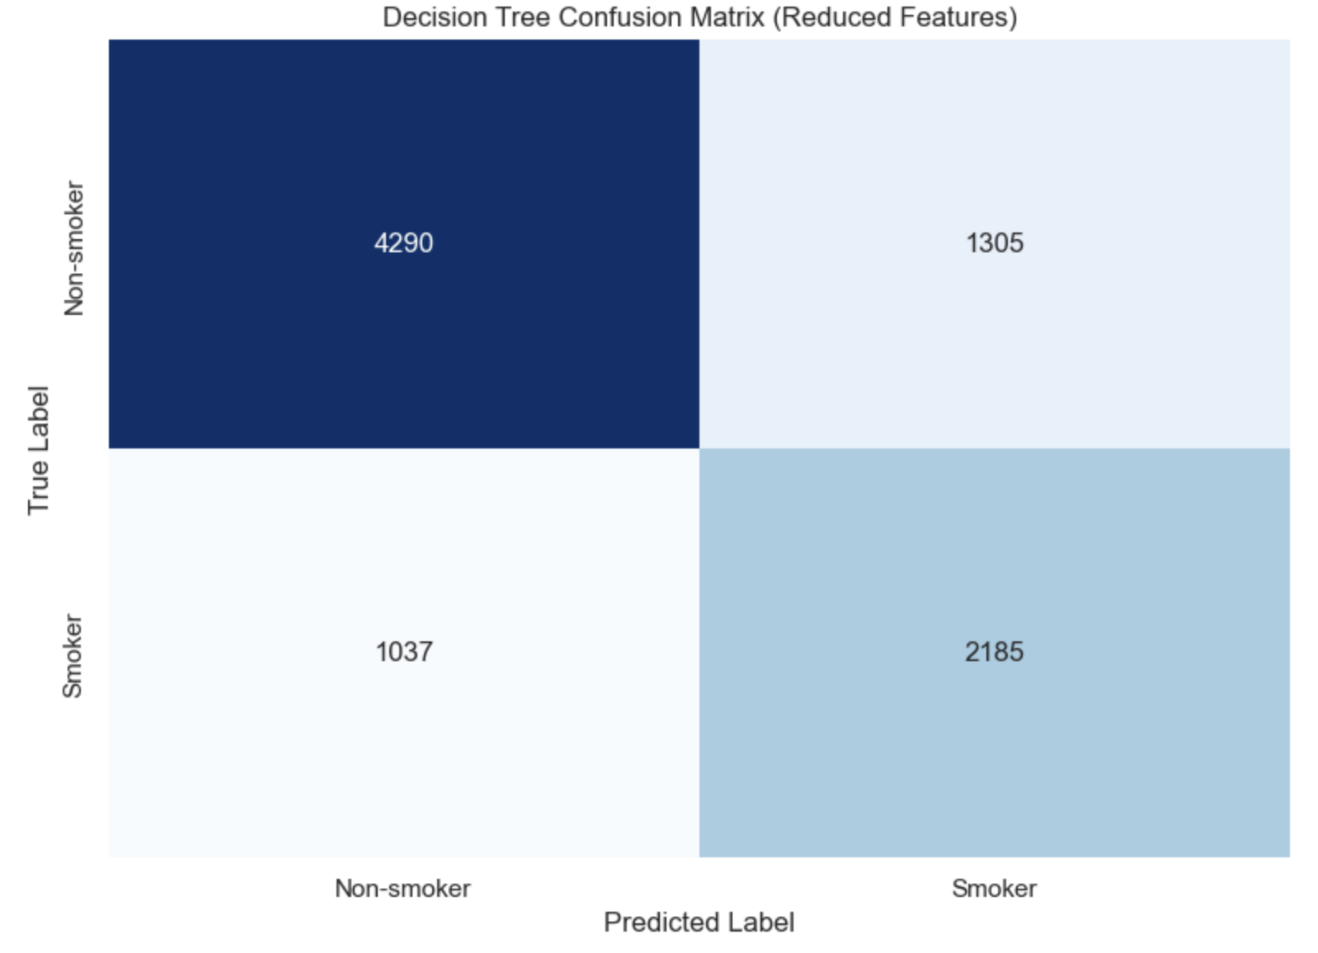
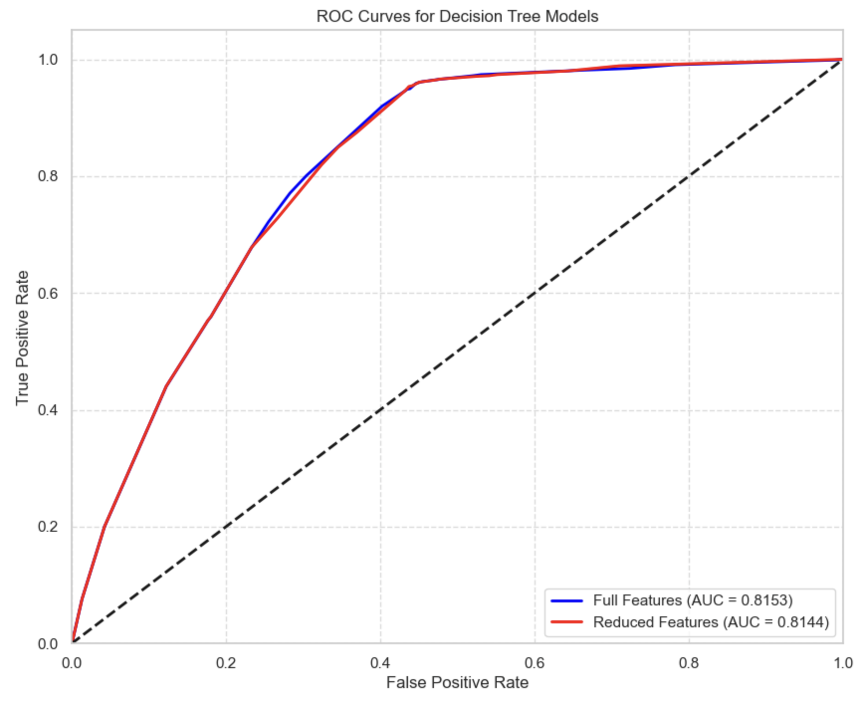
MODEL: DECISION TREE (CART)
Performance Metrics:
Metric | Full Features | Reduced Features
Accuracy | 0.736 | 0.734
Precision | 0.620 | 0.626
Recall | 0.722 | 0.678
F1 Score | 0.667 | 0.651
ROC AUC | 0.815 | 0.814
Observations:
Full feature set provides better recall (+4.3%)
Reduced feature set gives slightly better precision
Only 2.4% reduction in F1-score with reduced features
Minimal impact on ROC AUC (0.001 difference)
Simple tree structure provides excellent interpretability
Outperforms KNN on recall, accuracy, and ROC AUC

Slide 18
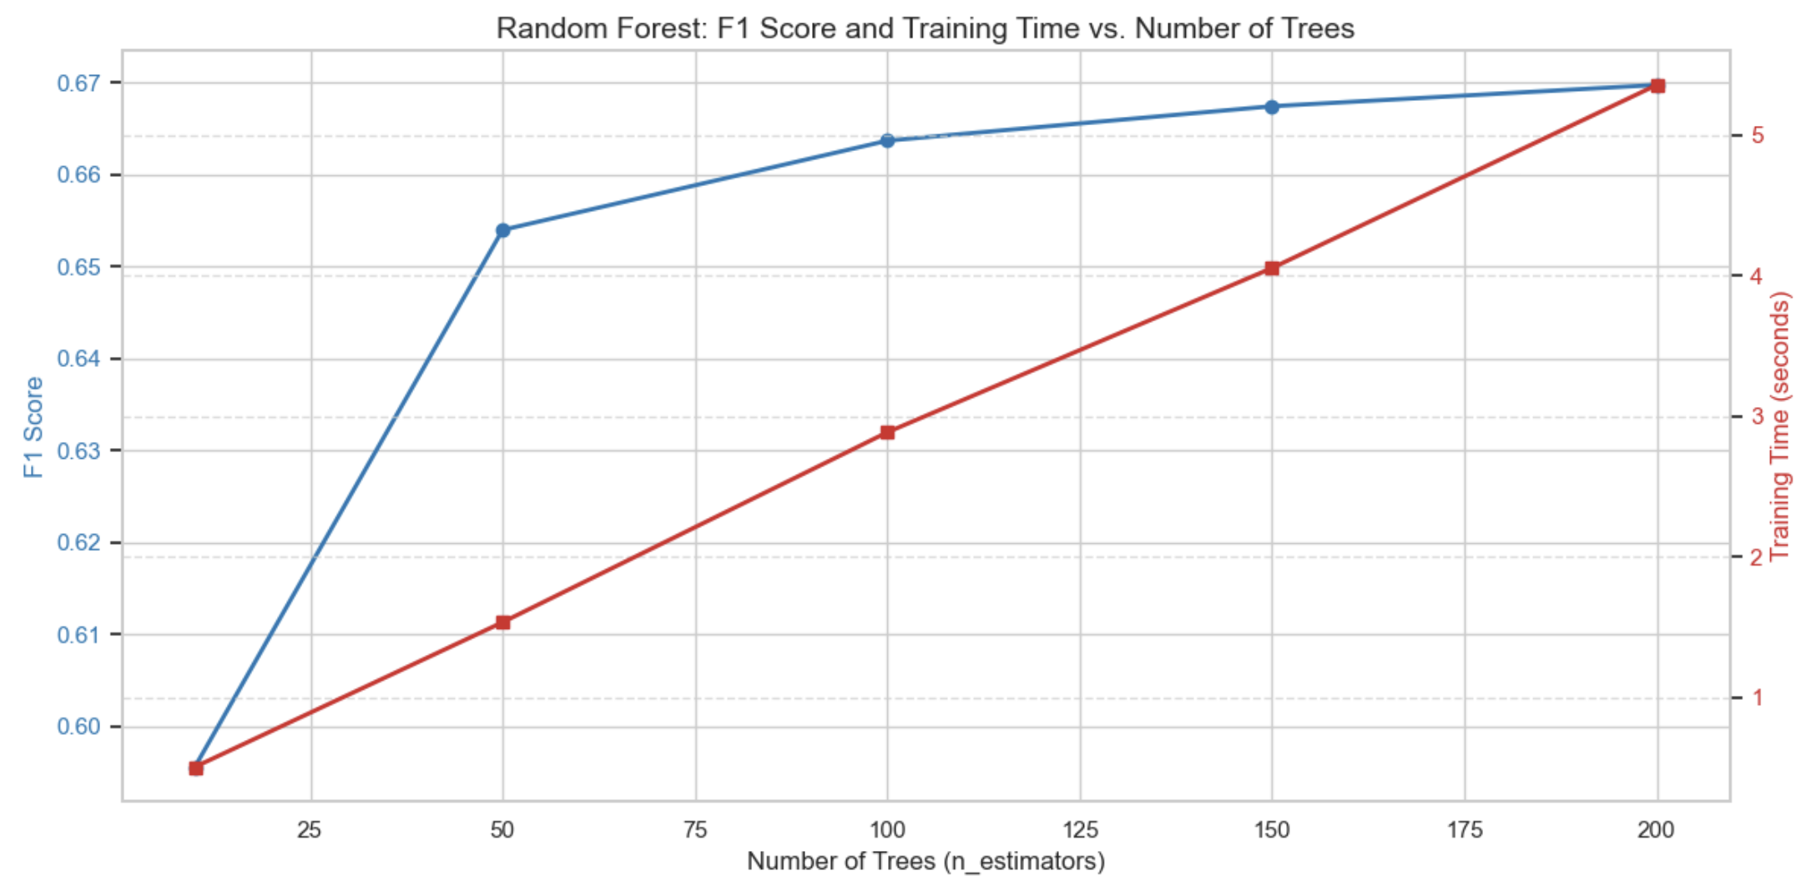
MODEL: RANDOM FOREST
Random Forest Approach:
Ensemble of decision trees, each trained on random data subsets
Each tree considers random feature subset when splitting
Final prediction by majority voting across all trees
Naturally handles feature interactions and non-linearities
More stable than single decision trees
Parameter Optimization Process:
Two-stage optimization:
First optimized n_estimators (number of trees): 10, 50, 100, 150, 200
Then optimized max_depth using best n_estimators: 5, 10, 15, 20, 25, 30, None
Measured both performance (F1-score) and training time
Results:
Best n_estimators: 200
Best max_depth: 10
F1-score: 0.68 (cross-validation)
Performance plateaus after 150 trees

Slide 19
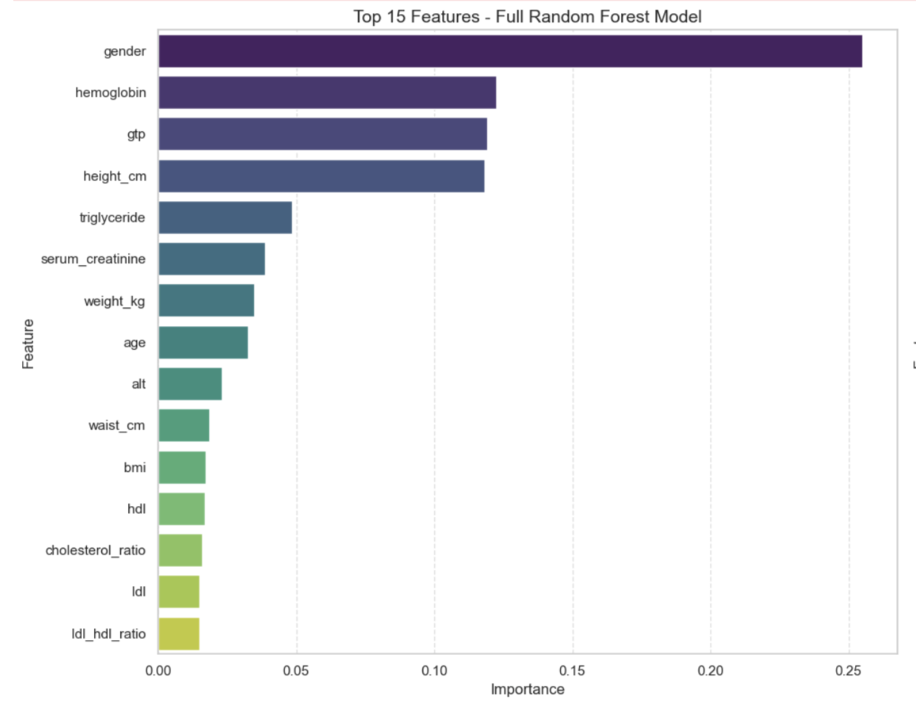
MODEL: RANDOM FOREST
Feature Importance Analysis:
More balanced feature importance distribution than single tree
Less dominated by gender (25% vs. 83% in single tree)
Considers complex feature interactions
Top Important Features:
Gender (0.25) - Still most important, but more balanced
Hemoglobin (0.12) - Affected by carbon monoxide from smoking
GTP (0.12) - Liver enzyme elevated in smokers
Height (0.12) - Correlates with gender differences
Triglyceride (0.05) - Lipid affected by smoking

Slide 20
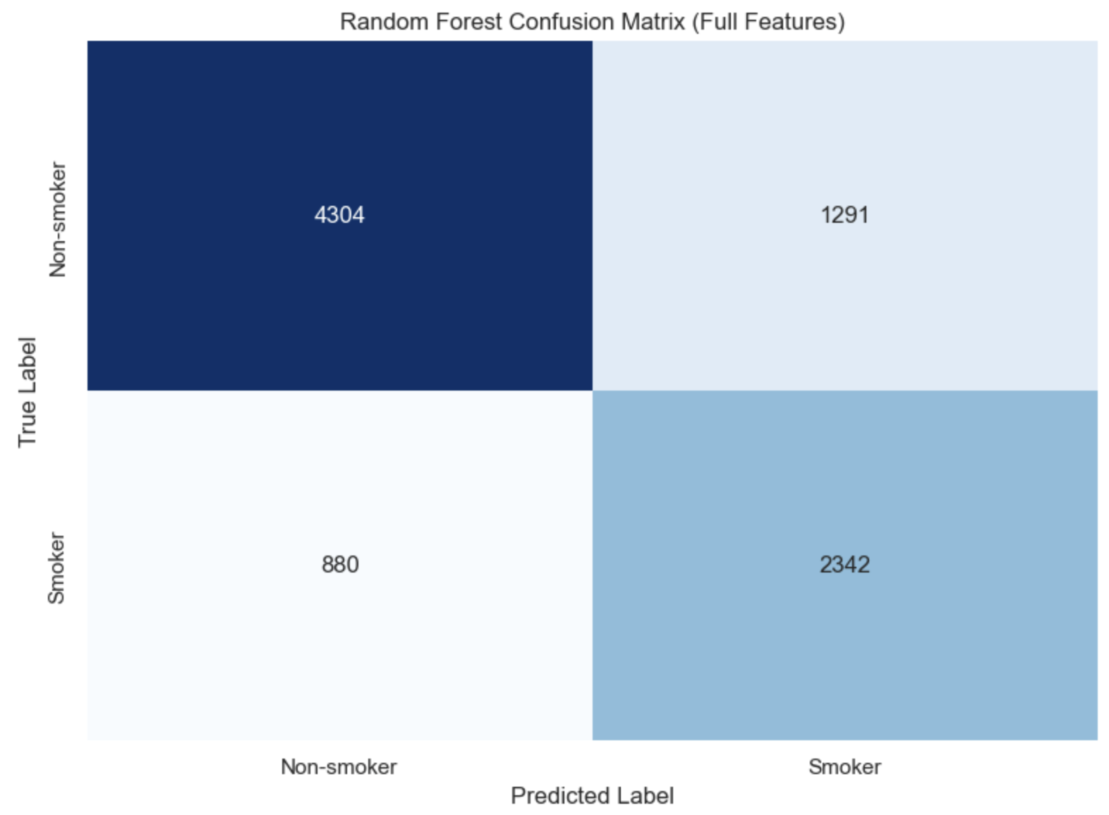
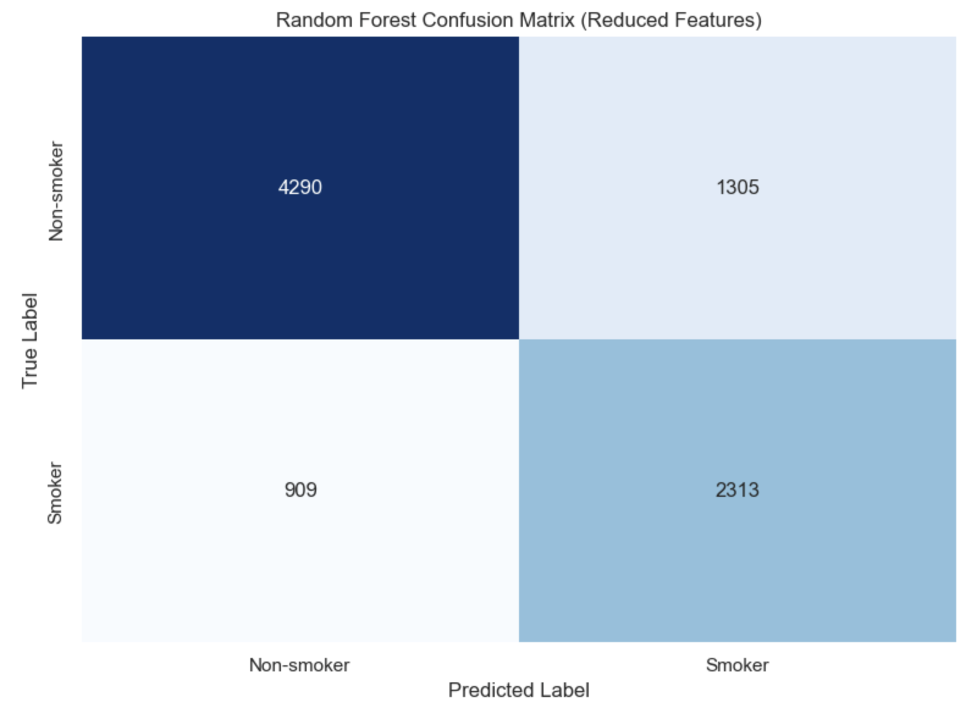
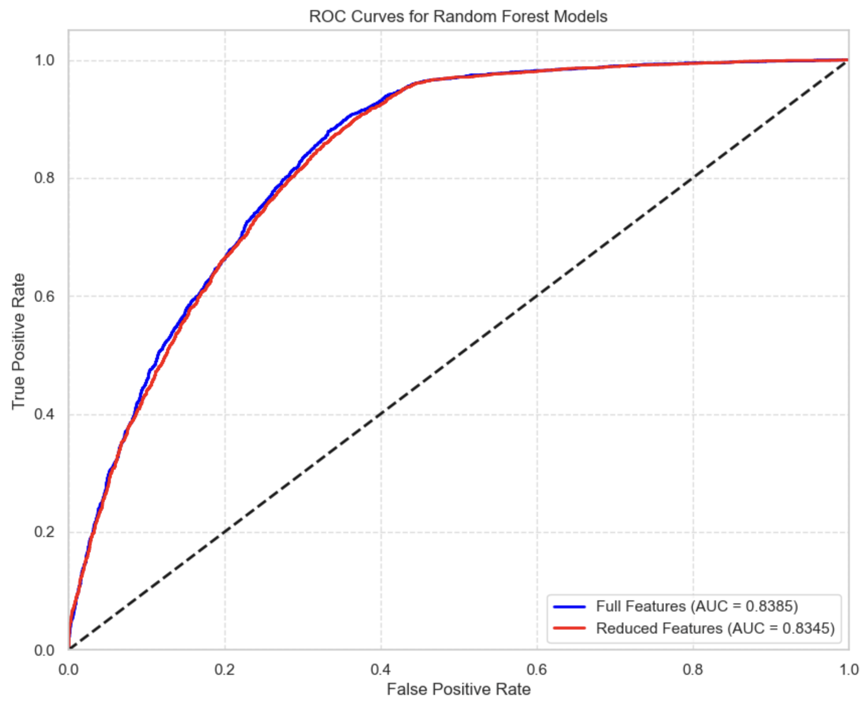
MODEL: RANDOM FOREST
Performance Metrics:
Metric | Full Features | Reduced Features
Accuracy | 0.754 | 0.749
Precision | 0.645 | 0.639
Recall | 0.727 | 0.718
F1 Score | 0.683 | 0.676
ROC AUC | 0.838 | 0.835
Key Observations:
Highest accuracy among all models tested
Best performing tree-based model across all metrics
Strong balance between precision and recall
Only 1% reduction in F1-score with reduced features
Highest ROC AUC (0.838) indicates excellent discrimination

Slide 21
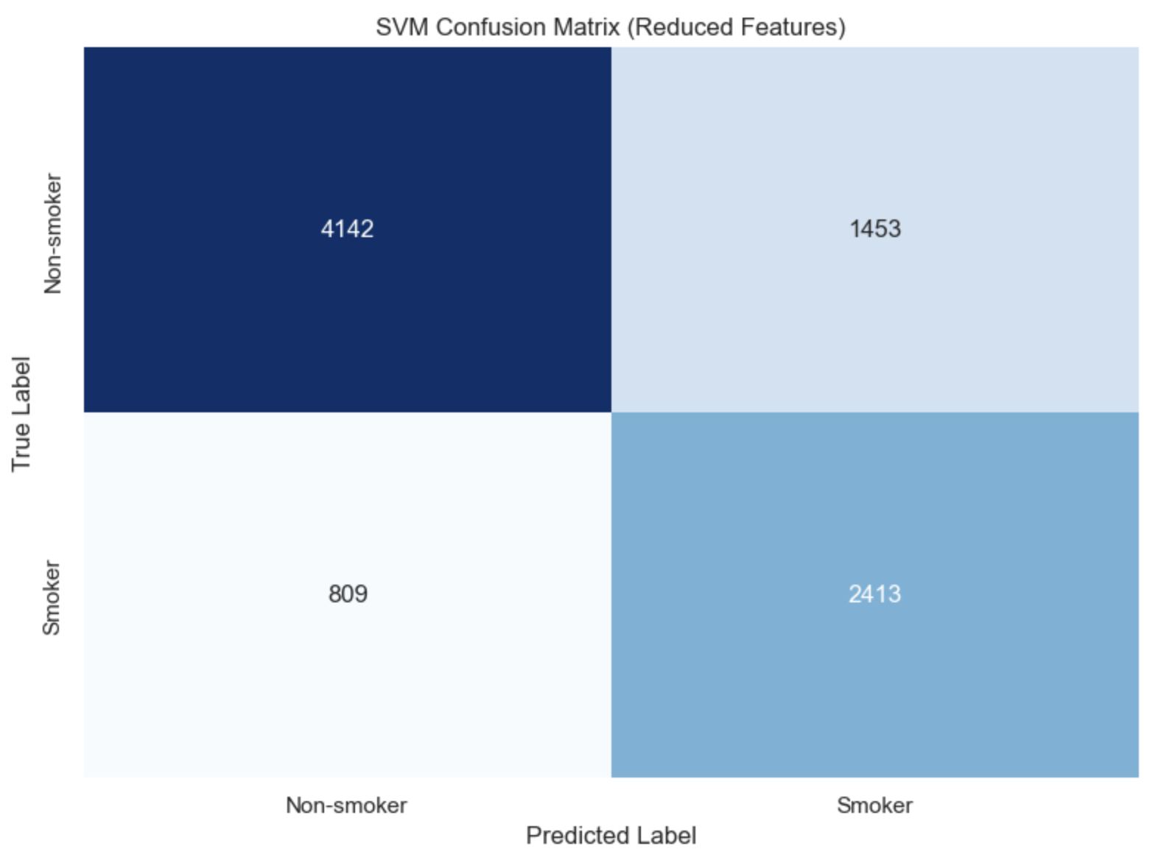

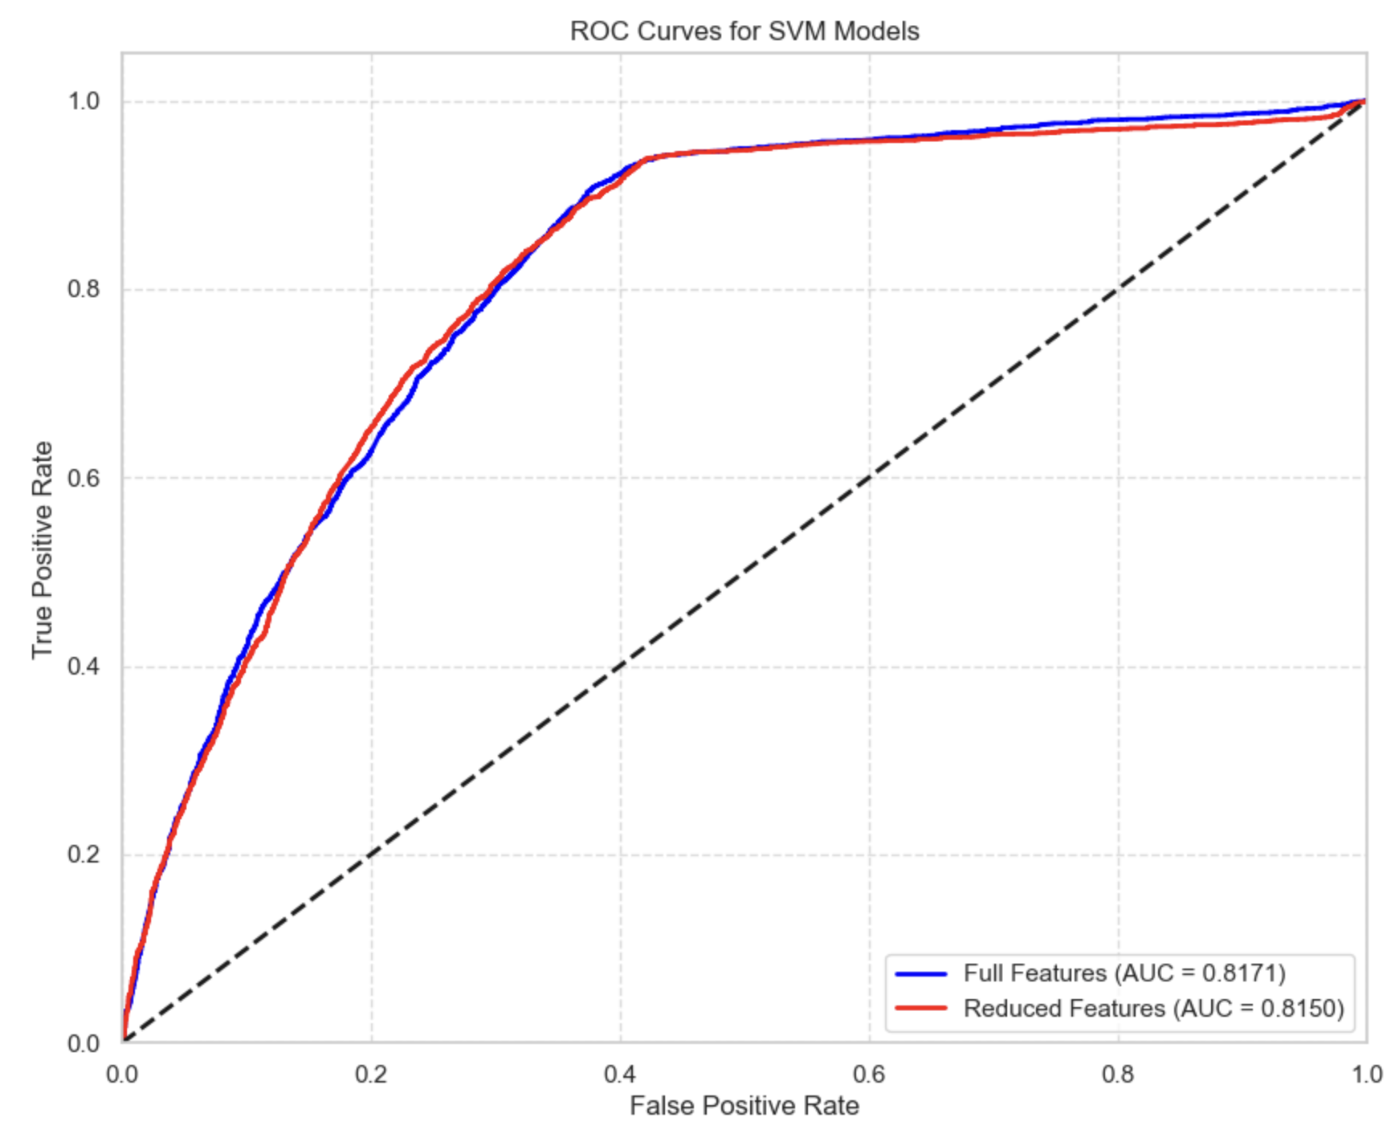
MODEL: SVM
SVM Implementation Details:
Support Vector Machine finds optimal hyperplane separating classes
Used Radial Basis Function (RBF) kernel for non-linear boundaries
Feature scaling with MinMaxScaler crucial for SVM performance
Probability estimation enabled for ROC AUC calculation
Default parameters used: C=1.0, gamma='scale
Performance Metrics:
Metric | Full Features | Reduced Features
Accuracy | 0.738 | 0.743
Precision | 0.619 | 0.624
Recall | 0.739 | 0.749
F1 Score | 0.673 | 0.681
ROC AUC | 0.817 | 0.815
Key Observations:
Reduced feature set performs better than full set (+1.2% F1-score)
Higher recall and precision with fewer features
Suggests SVM handles dimension reduction well
Improved accuracy, precision, and recall with reduced features
Good balance of precision and recall makes it versatile

Slide 22
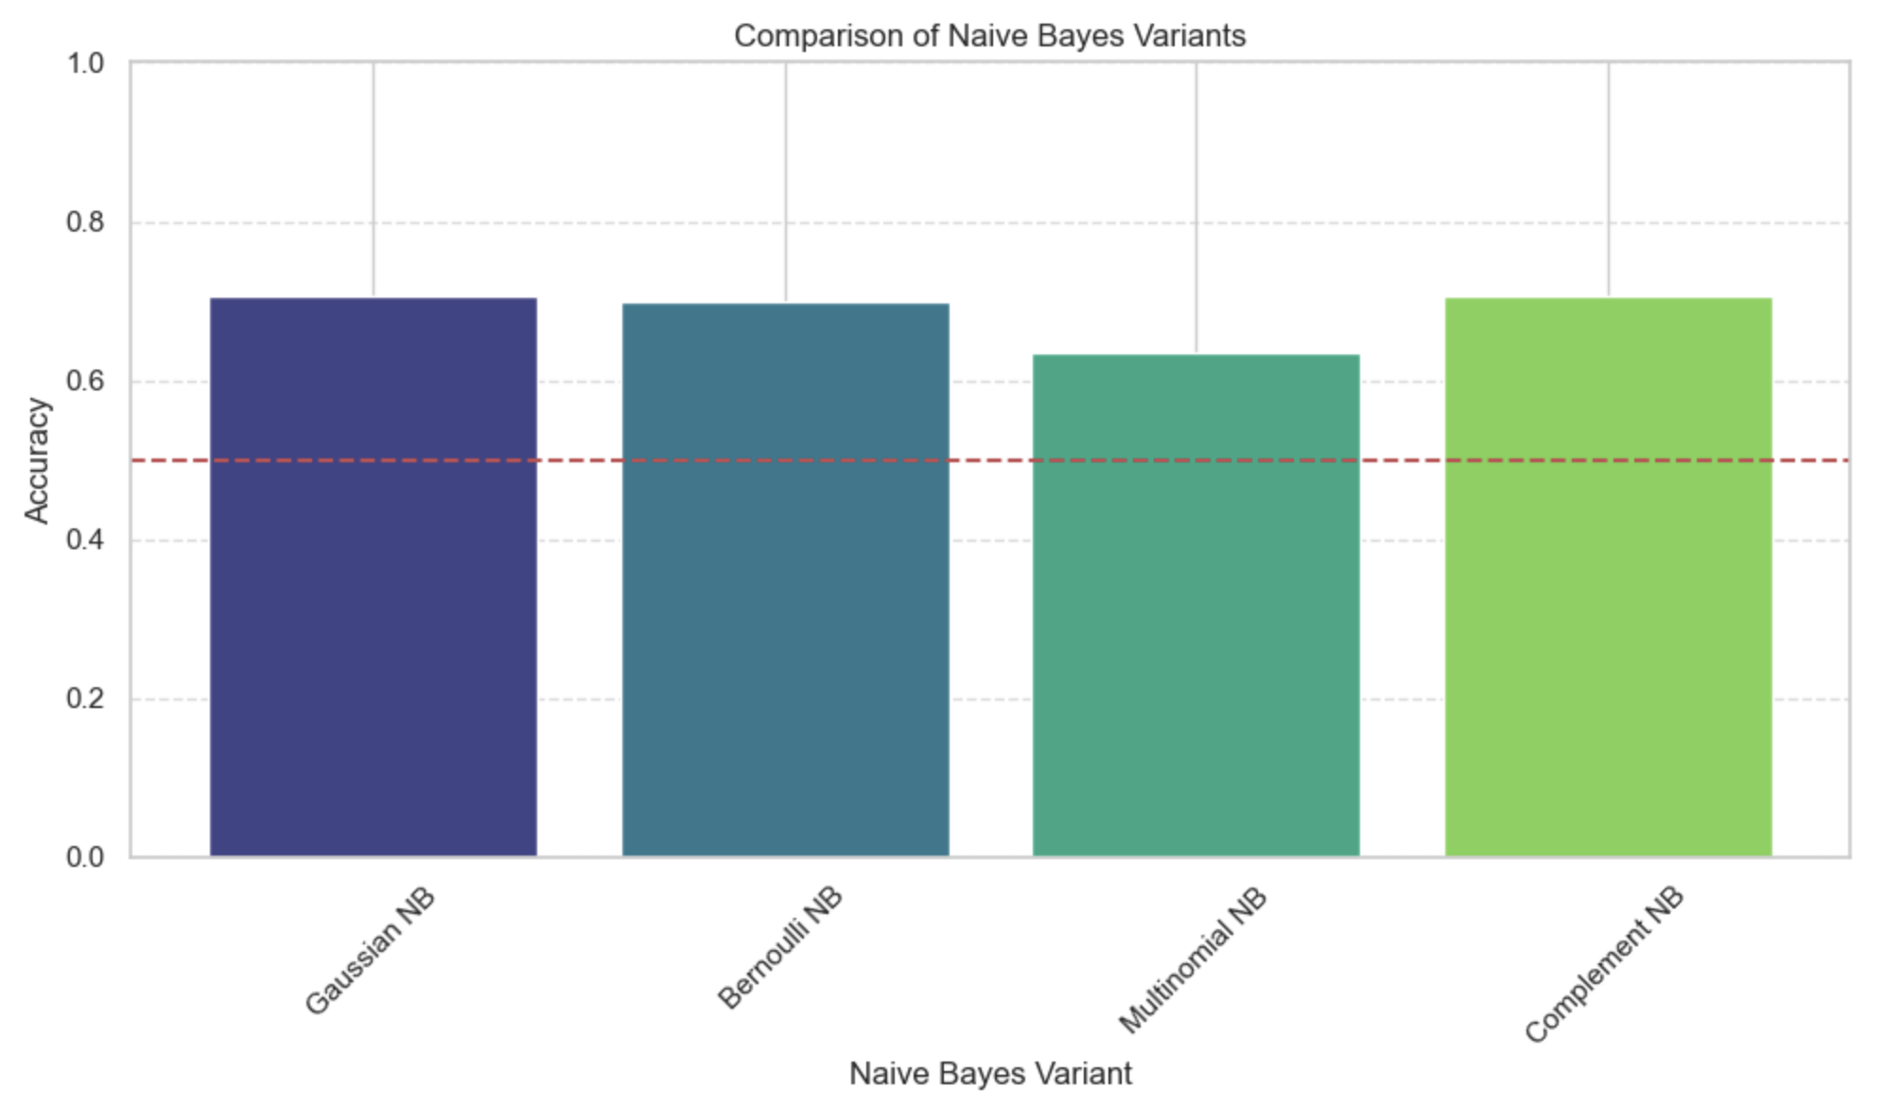
MODEL: NAIVE BAYES
Naive Bayes Approach:
Probabilistic classifier based on Bayes' theorem
"Naive" assumption: features are conditionally independent
Different variants handle different data distributions
Fast training and prediction, even with large datasets
Variants Tested:
Gaussian NB: Assumes features follow normal distribution
Bernoulli NB: For binary/boolean features after binarization
Multinomial NB: For discrete count data (non-negative features)
Complement NB: For imbalanced datasets (non-negative features)
Variant Performance:
Gaussian NB: Accuracy = 0.706
Bernoulli NB: Accuracy = 0.700
Multinomial NB: Accuracy = 0.635
Complement NB: Accuracy = 0.706
Selection Rationale:
Gaussian NB performs best, matching our continuous health indicators
Selected Gaussian NB for full evaluation on both feature sets

Slide 23
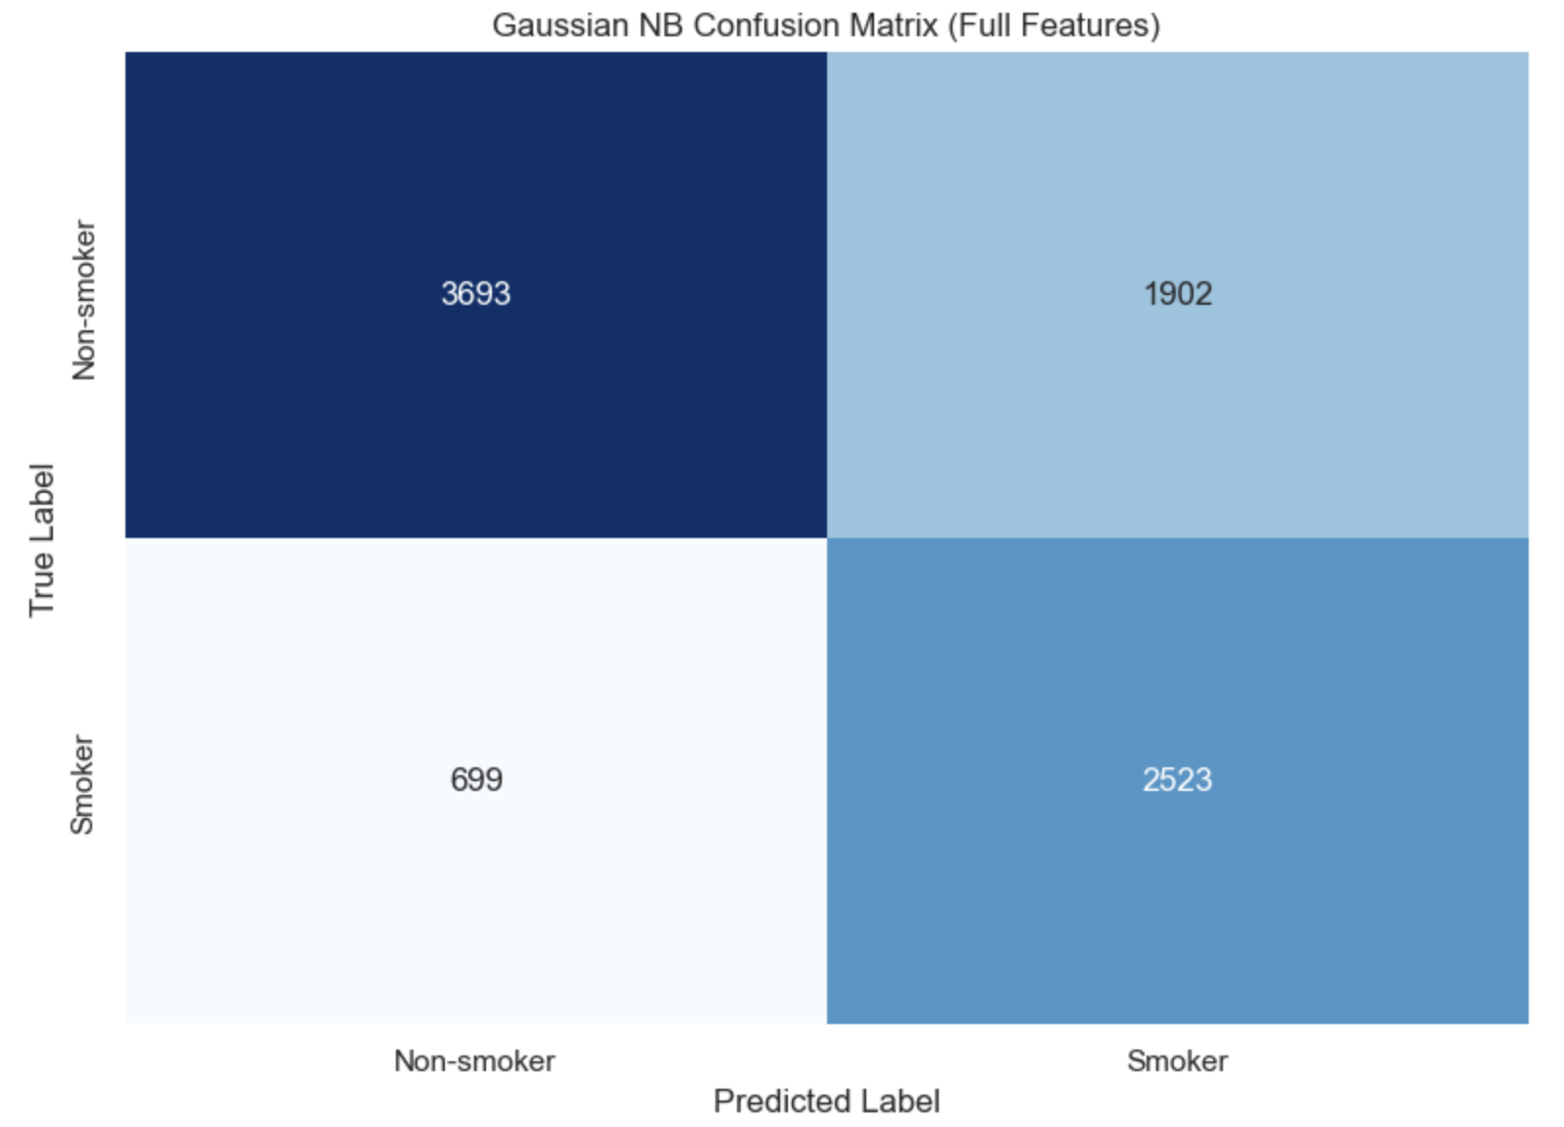
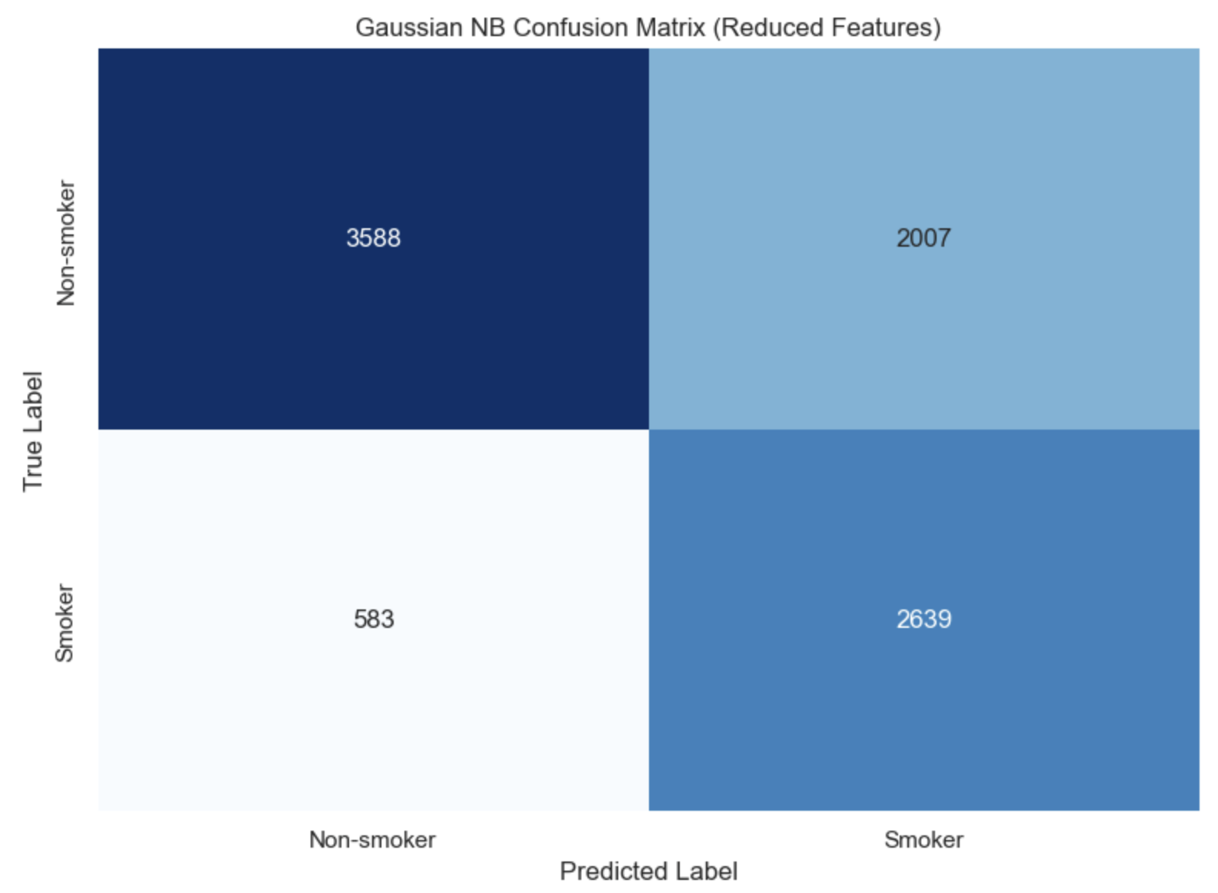
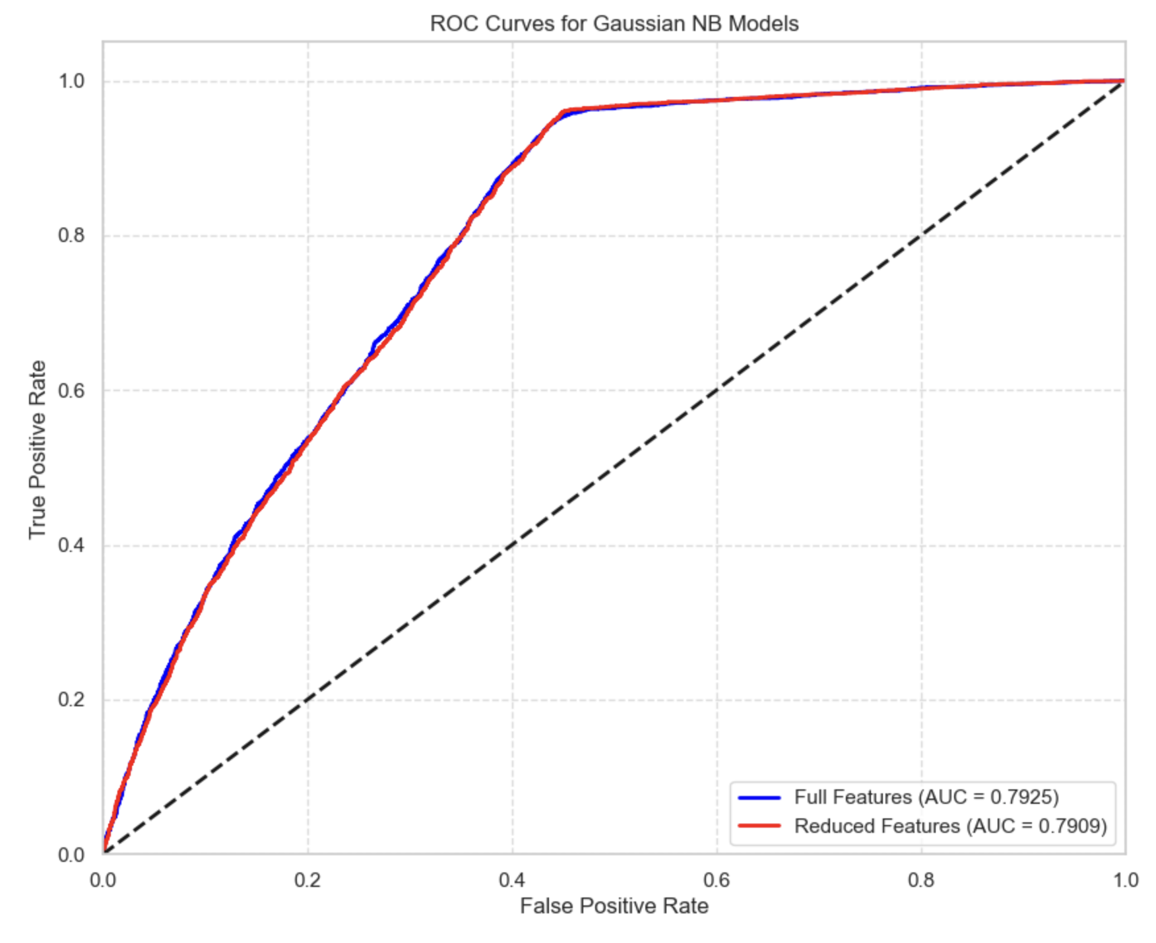
MODEL: NAIVE BAYES
Implementation Details:
Applied Gaussian NB to both feature sets
No feature scaling required (algorithm accounts for feature distributions)
Default parameters used (no hyperparameter tuning needed)
Priors calculated automatically from class frequencies
Fastest training time of all models tested
Performance Metrics:
Metric | Full Features | Reduced Features
Accuracy | 0.705 | 0.706
Precision | 0.570 | 0.568
Recall | 0.783 | 0.819
F1 Score | 0.660 | 0.671
ROC AUC | 0.793 | 0.791
Key Observations:
Highest recall among all models (up to 82%)
Particularly good at identifying true smokers (low false negatives)
Lower precision indicates more false positives
Reduced feature set improves recall by 3.6%
Independence assumption may explain lower overall accuracy

Slide 24
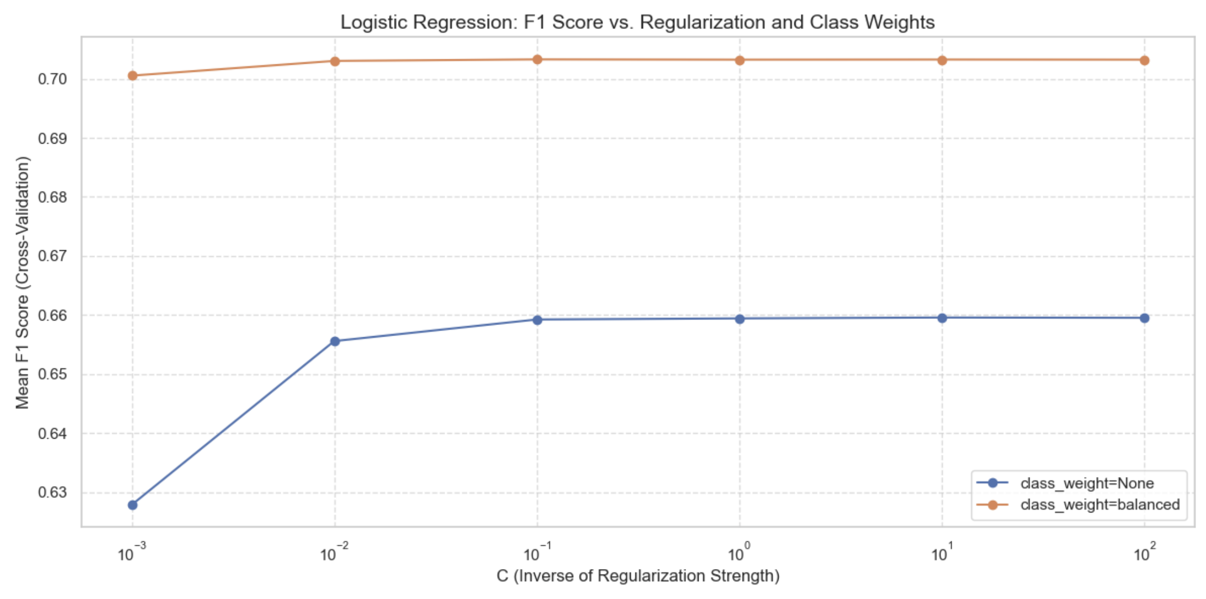
MODEL: LOGISTIC REGRESSION
About Logistic Regression:
Linear model for binary classification
Predicts probability using logistic function transformation
Models log-odds of positive class as linear combination of features
Coefficients directly indicate feature importance and direction
Widely used in medical and epidemiological research
Optimization Approach:
Tested regularization strengths (C values: 0.001 to 100)
C controls inverse of regularization strength
Smaller C = stronger regularization = simpler model
Explored class weight options:
None: Equal importance to all classes
'balanced': Weights inversely proportional to class frequencies
Best Parameters:
C = 0.1 (moderate regularization)
class_weight = 'balanced'
Best Cross-Validation F1 Score: 0.703

Slide 25
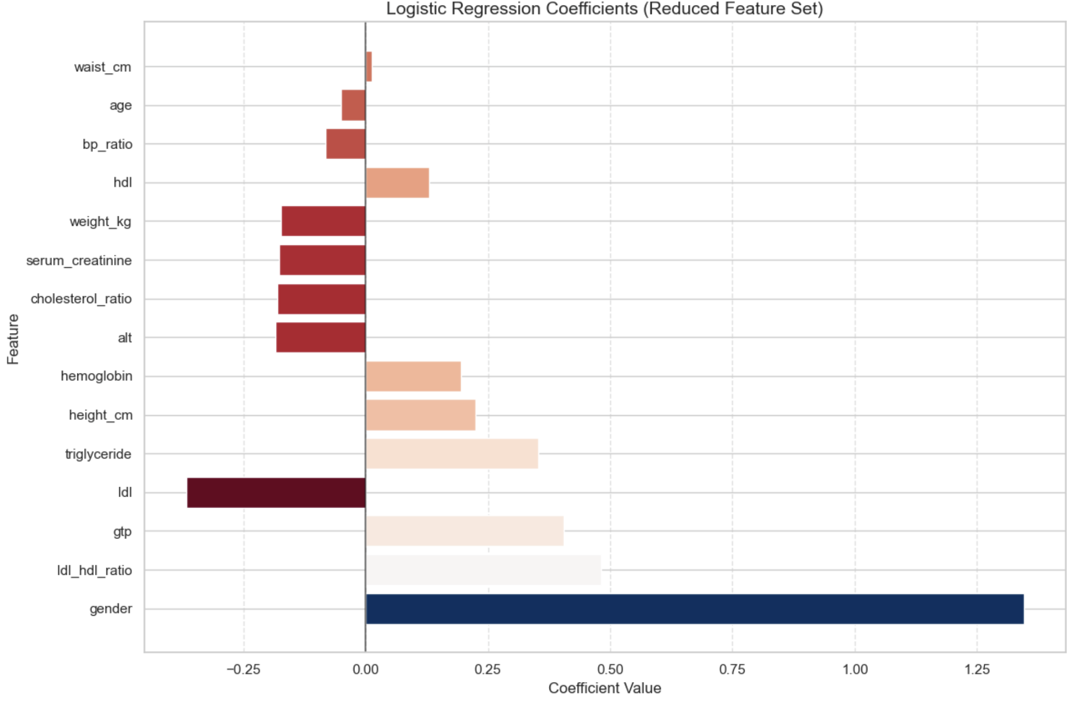
MODEL: LOGISTIC REGRESSION
Coefficient Interpretation:
Each coefficient represents log-odds change per unit feature increase
Positive coefficient: feature increases smoking probability
Negative coefficient: feature decreases smoking probability
Magnitude indicates strength of effect
Top Positive Coefficients:
Gender: 1.346 (Males much more likely to be smokers)
LDL/HDL ratio: 0.481 (Higher ratio associated with smoking)
GTP: 0.405 (Elevated liver enzyme in smokers)
Triglyceride: 0.354 (Higher levels in smokers)
Height: 0.225 (Taller individuals more likely smokers)
Top Negative Coefficients:
LDL: -0.367 (Lower "bad" cholesterol in smokers)
ALT: -0.184 (Liver Enzyme)
Cholesterol ratio: -0.181 (Complex lipid interactions)
Serum creatinine: -0.178 (Kidney function marker)
Weight: -0.174 (Complex relationship with smoking)

Slide 26
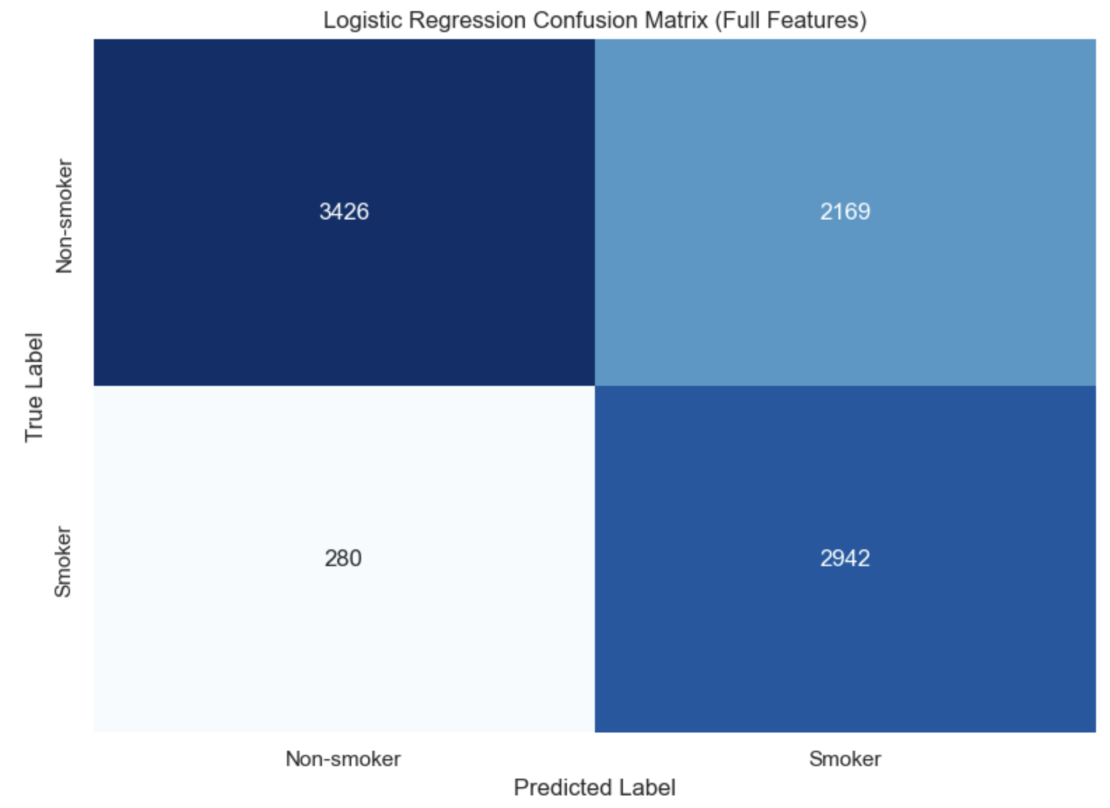
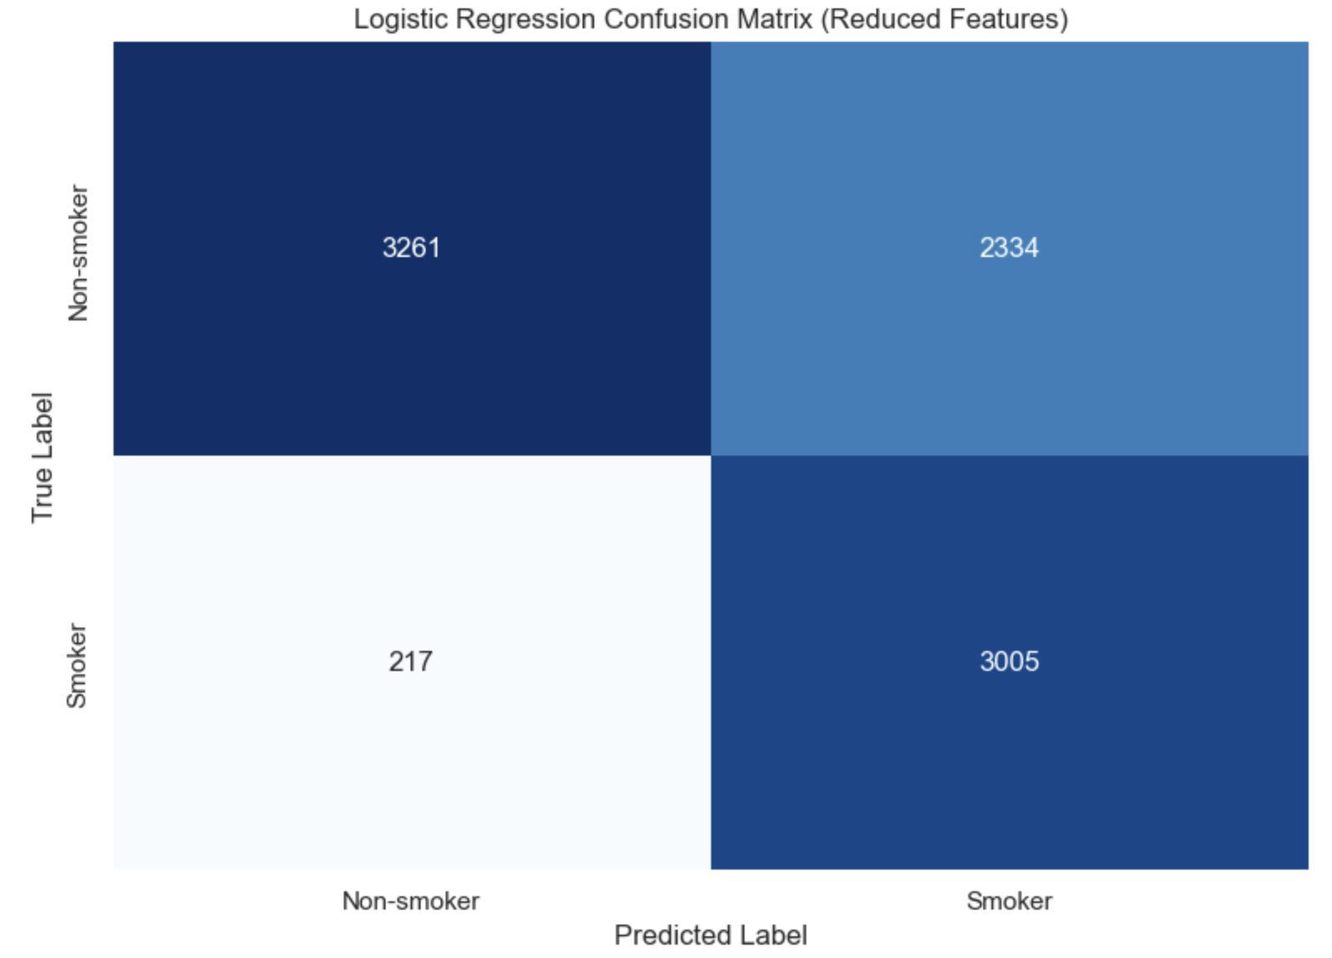
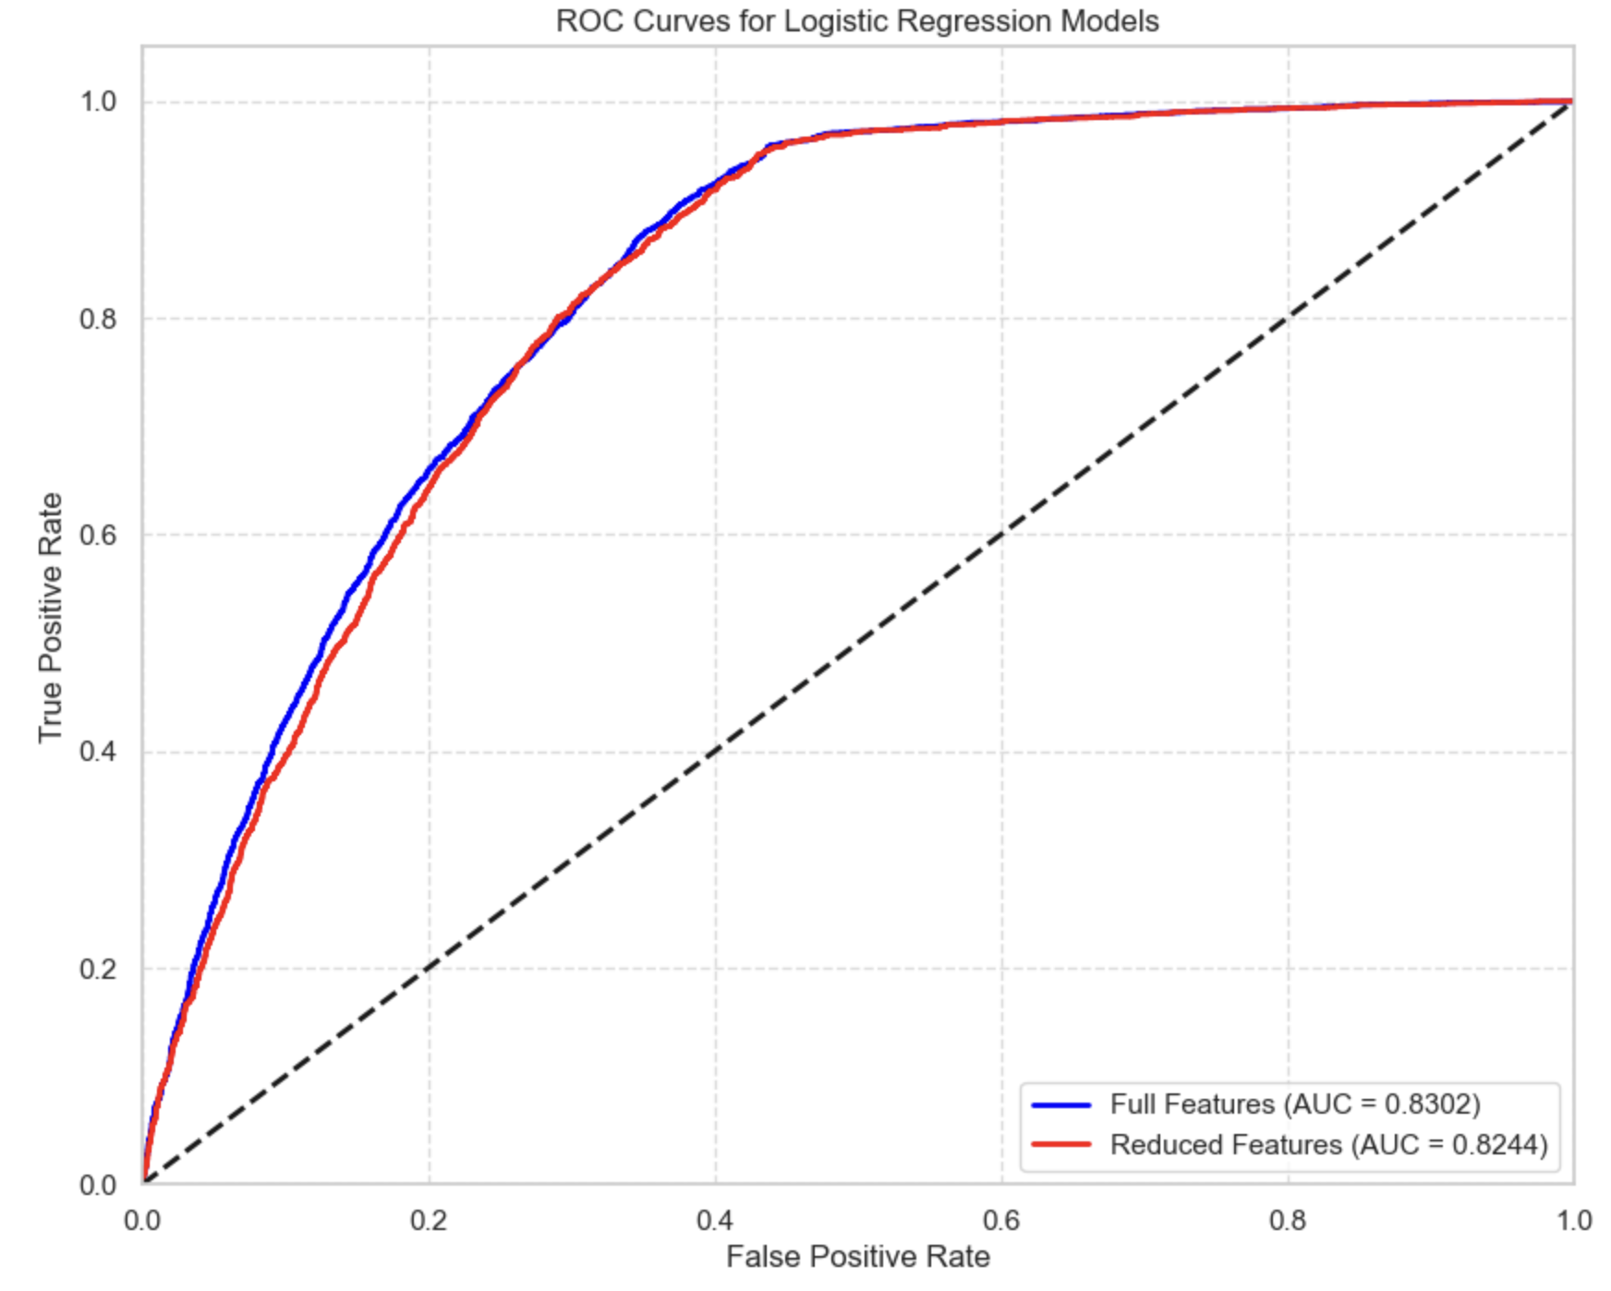
MODEL: LOGISTIC REGRESSION
Performance Metrics:
Metric | Full Features | Reduced Features
Accuracy | 0.722 | 0.711
Precision | 0.576 | 0.563
Recall | 0.913 | 0.933
F1 Score | 0.706 | 0.702
ROC AUC | 0.830 | 0.824
Key Observations:
Highest F1 score among all models
Outstanding recall performance (>90%)
Lower precision due to higher false positive rate
Excellent at identifying smokers (misses <10%)
Balanced class weights help address moderate class imbalance
Maintains strong performance with reduced features
Good balance between interpretability and performance

Slide 27
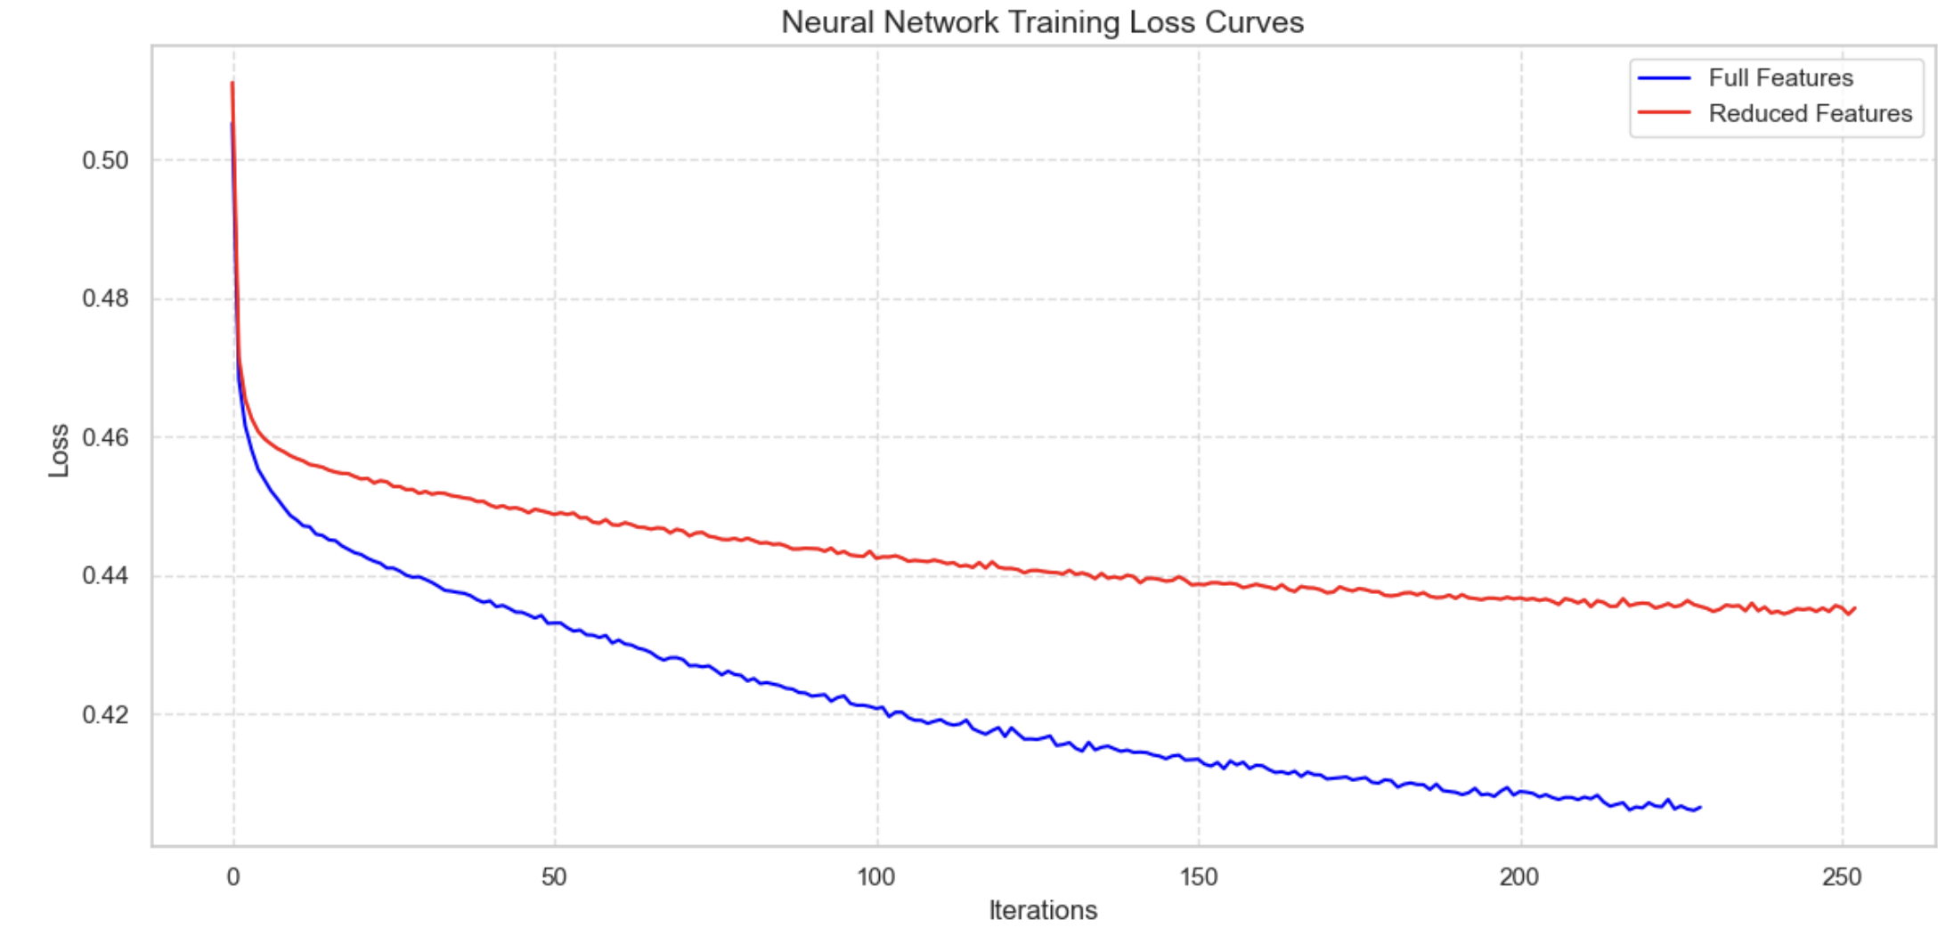
MODEL: ARTIFICIAL NEURAL NETWORK
Network Architecture:
Multi-Layer Perceptron (MLP) with scikit-learn implementation
Single hidden layer with 100 neurons
ReLU activation function for non-linearity
Adam optimizer for efficient training
Output layer with softmax activation for probabilities
Implementation Details:
Feature standardization with StandardScaler (critical for neural networks)
alpha=0.0001 for L2 regularization
batch_size='auto' for efficient training
max_iter=300 iterations for convergence
learning_rate_init=0.001

Slide 28
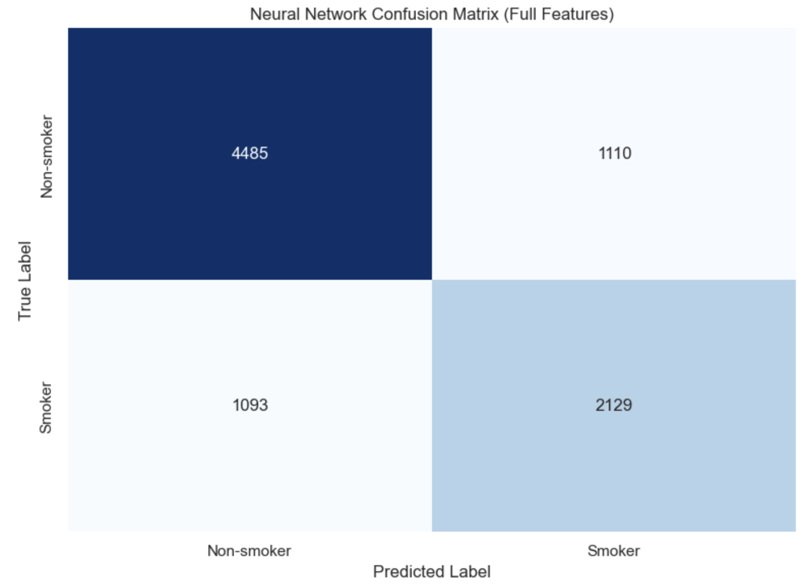
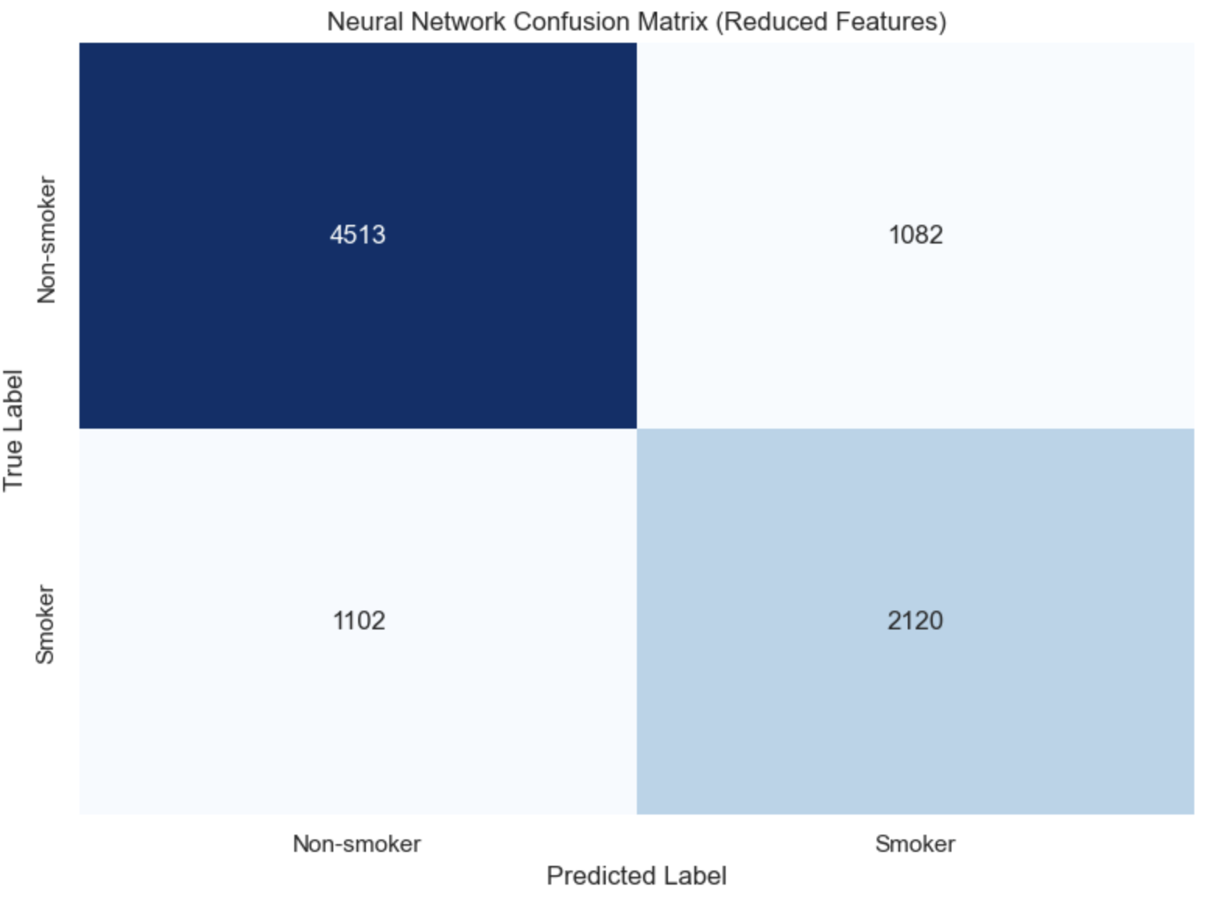
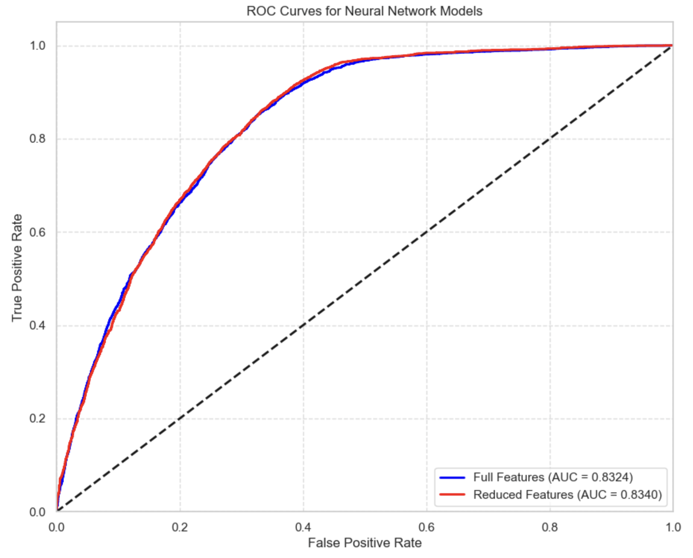
MODEL: ARTIFICIAL NEURAL NETWORK
Performance Metrics:
Metric | Full Features | Reduced Features
Accuracy | 0.750 | 0.752
Precision | 0.657 | 0.662
Recall | 0.661 | 0.658
F1 Score | 0.659 | 0.660
ROC AUC | 0.832 | 0.834
Key Observations:
Highest precision among all models
Second-highest ROC AUC (0.834)
Most balanced between precision and recall
Reduced feature set performs slightly better
Strong overall discrimination ability
Less interpretable than other models
Good choice when precision is critical

Slide 29
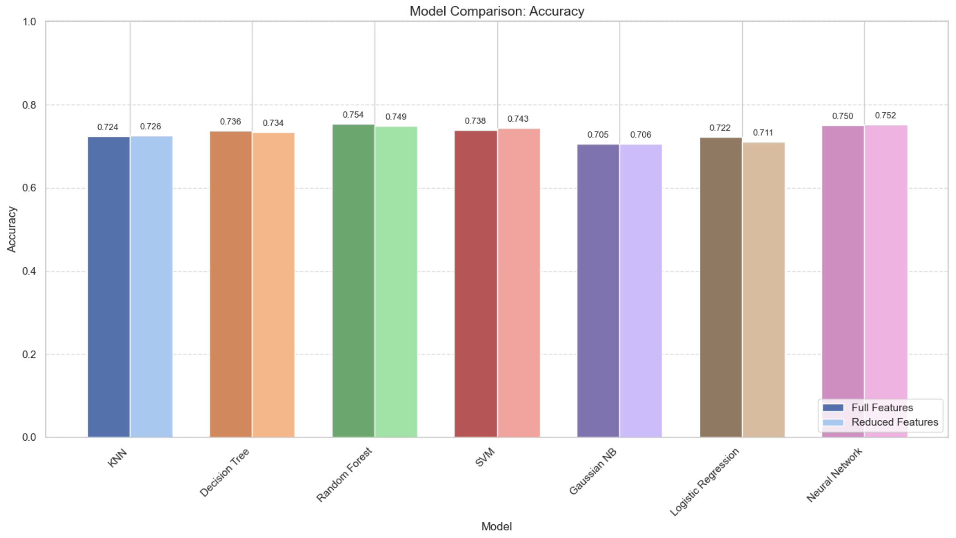
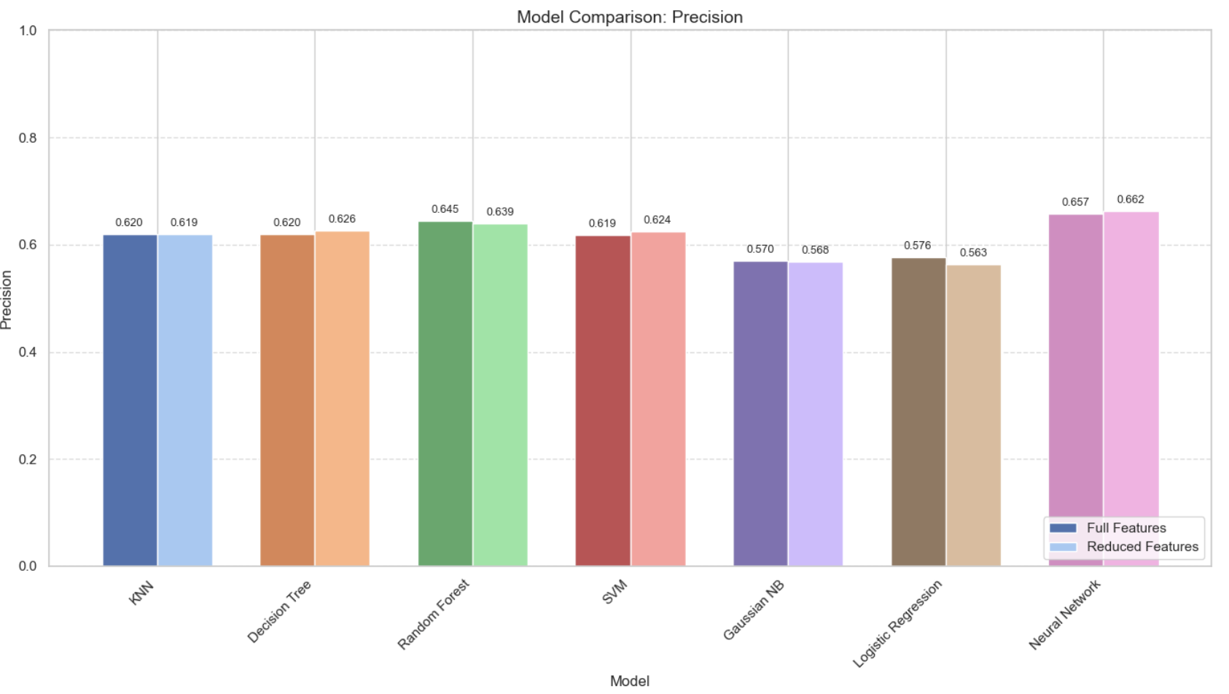
MODEL COMPARISON - ACCURACY & PRECISION
Accuracy Comparison:
Random Forest (Full): 0.754 [Highest]
Neural Network (Reduced): 0.752
Random Forest (Reduced): 0.749
SVM (Reduced): 0.743
Decision Tree (Full): 0.736
Precision Comparison:
Neural Network (Reduced): 0.662 [Highest]
Neural Network (Full): 0.657
Random Forest (Full): 0.645
Random Forest (Reduced): 0.639
SVM (Reduced): 0.624
Observations:
Tree-based models and neural networks lead in accuracy
Random Forest edges out Neural Network by small margin
Most models maintain accuracy within ~2% with reduced features
75% accuracy is strong given the challenging nature of the prediction task
Neural Network provides most precise predictions
Feature reduction has minimal impact on precision for most models

Slide 30
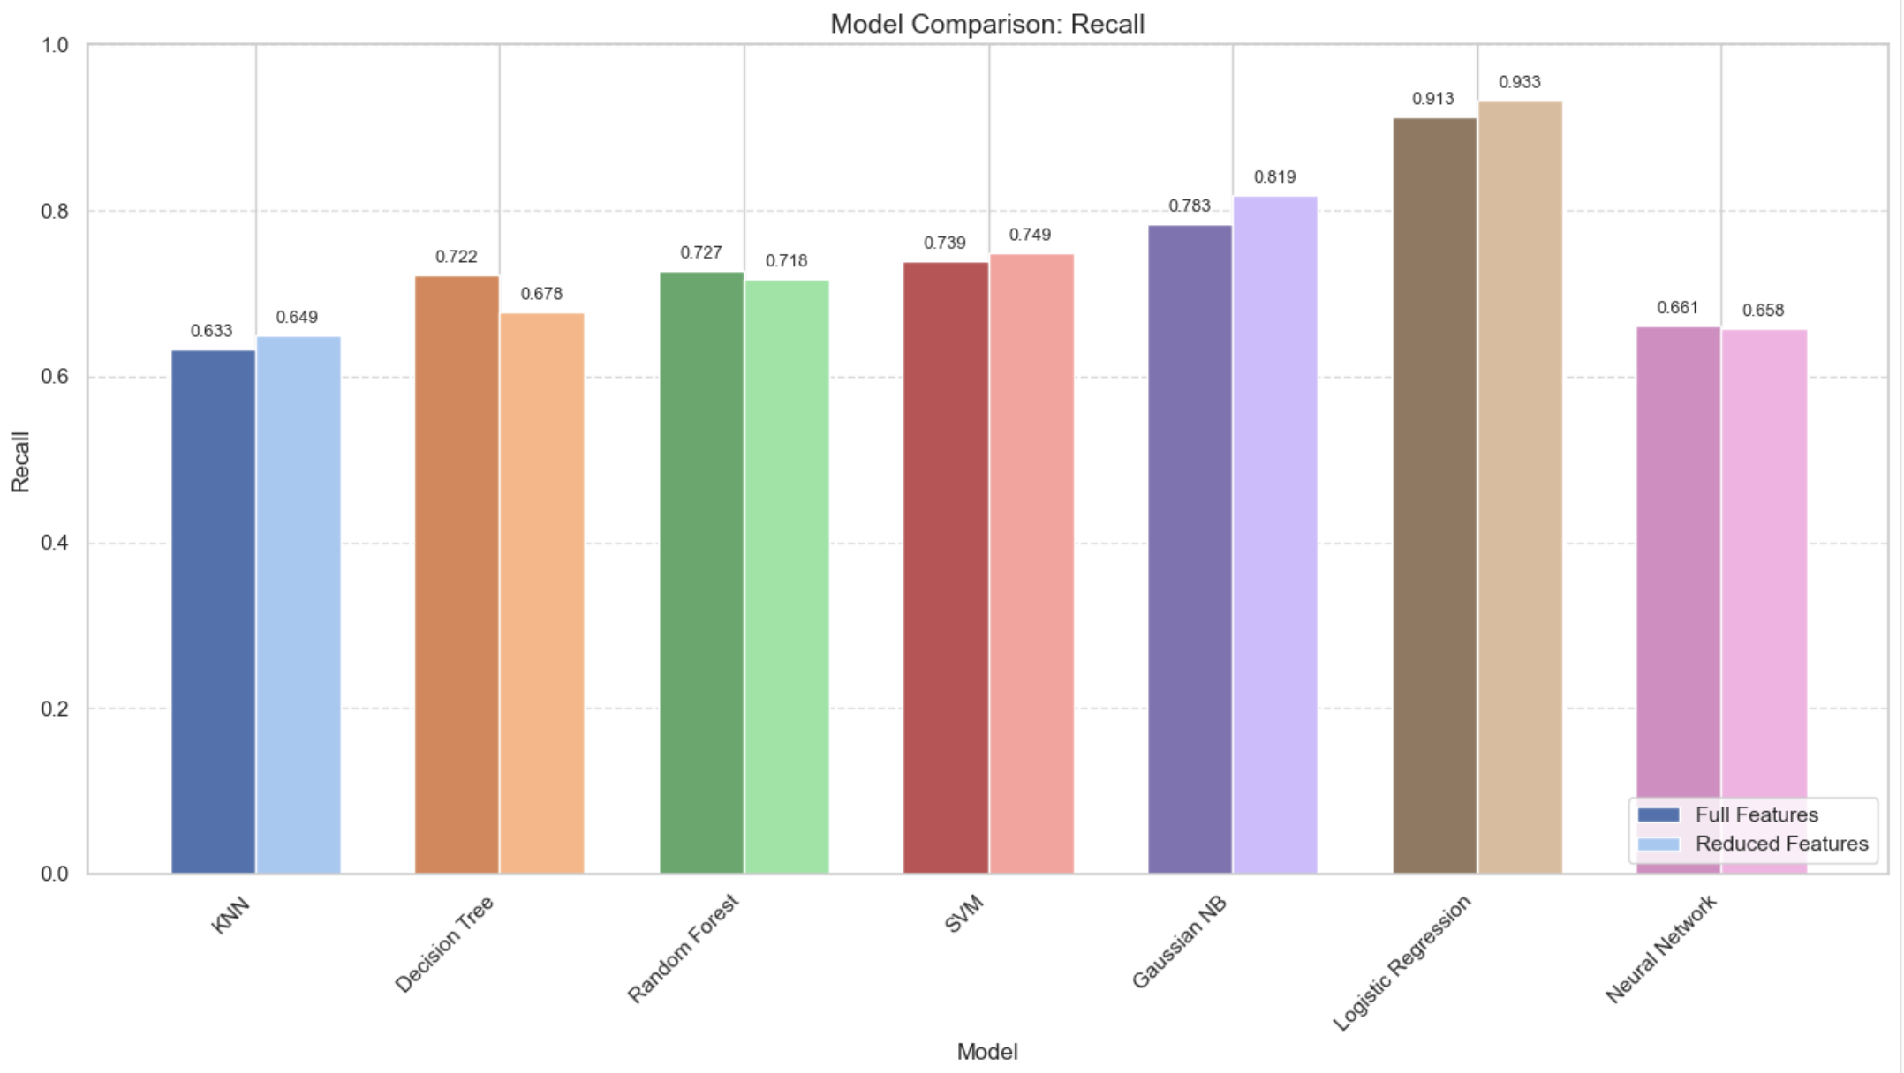
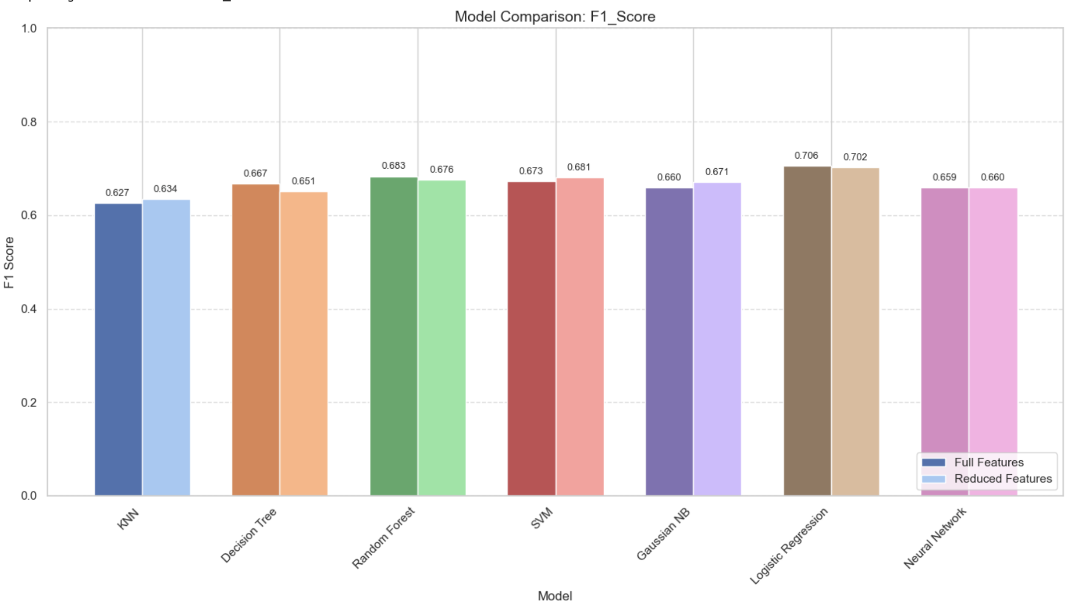
MODEL COMPARISON - RECALL & F1 SCORE
Recall Comparison:
Logistic Regression (Reduced): 0.933 [Highest]
Logistic Regression (Full): 0.913
Naive Bayes (Reduced): 0.819
Naive Bayes (Full): 0.783
SVM (Reduced): 0.749
F1 Score Comparison:
Logistic Regression (Full): 0.706 [Highest]
Logistic Regression (Reduced): 0.702
Random Forest (Full): 0.683
SVM (Reduced): 0.681
Random Forest (Reduced): 0.676
Observations:
Logistic Regression and Naive Bayes excel at finding smokers
Logistic Regression achieves best overall balance (F1)
Different models have different strengths for specific metrics
Model choice should depend on whether false positives or false negatives are more concerning
All models show strong F1 scores (>0.65) indicating good overall performance

Slide 31
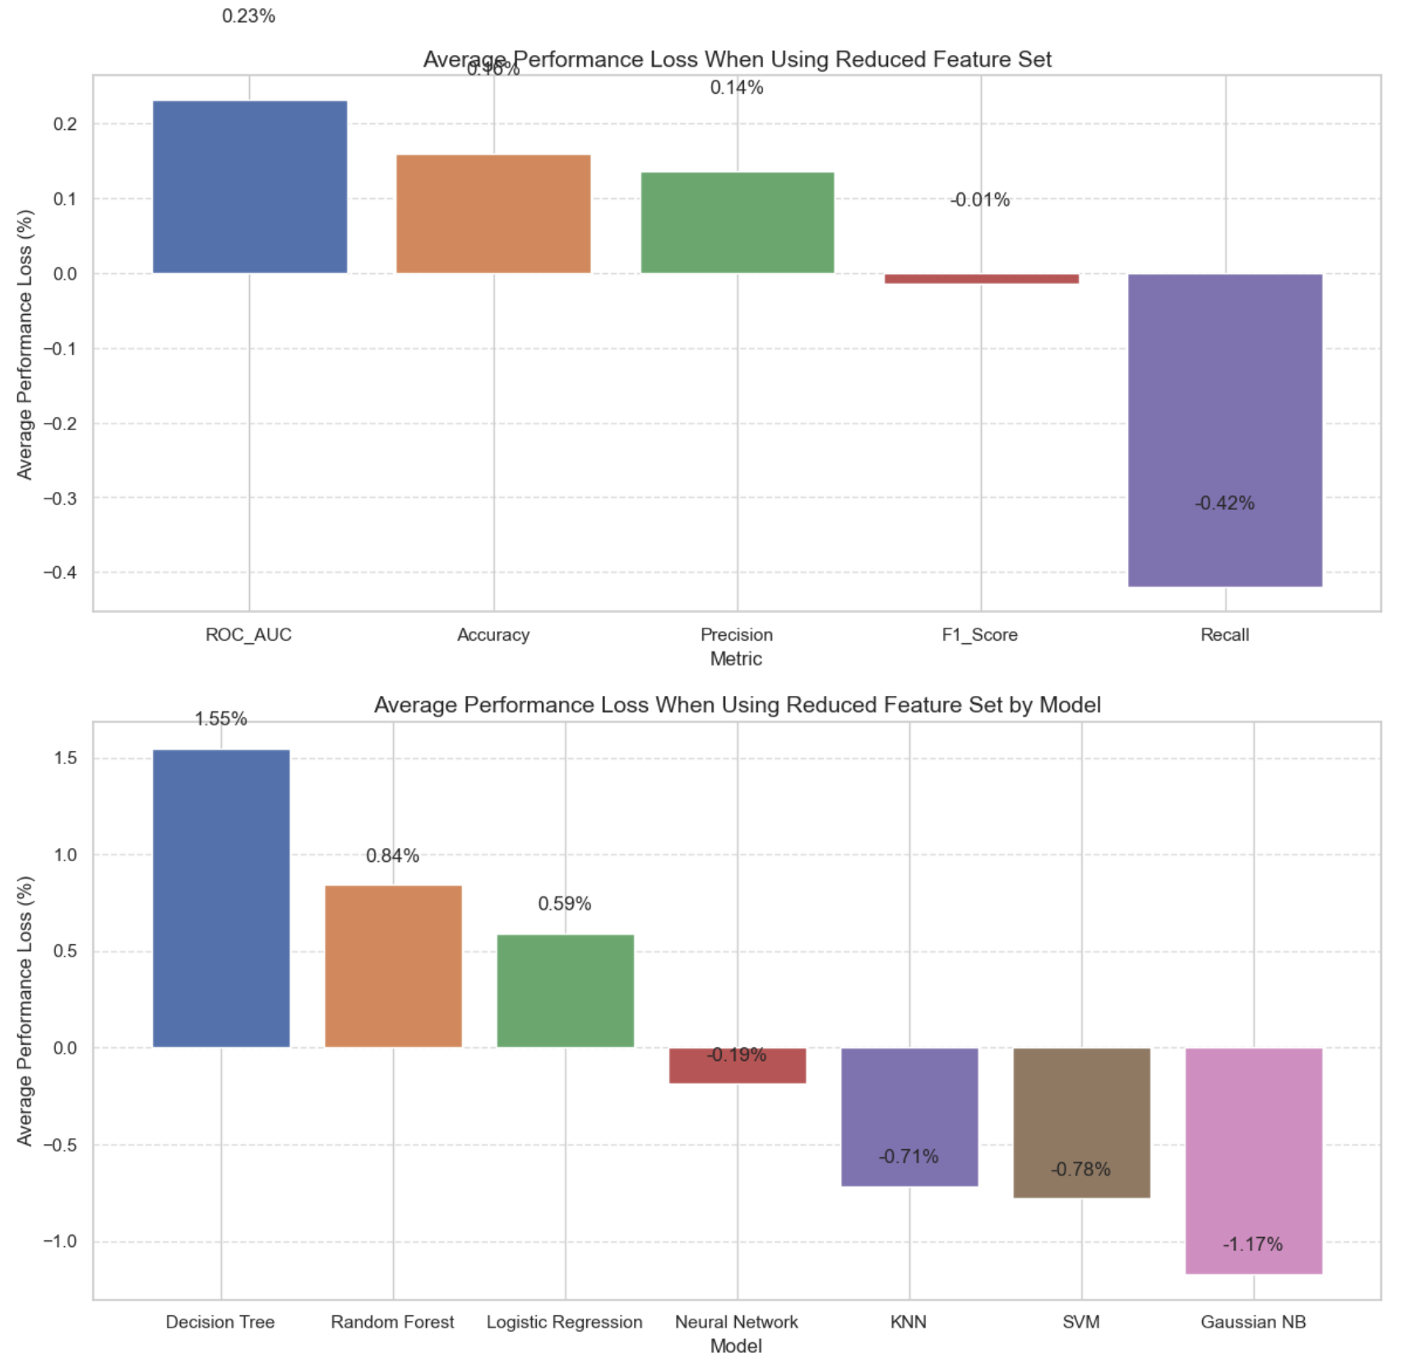
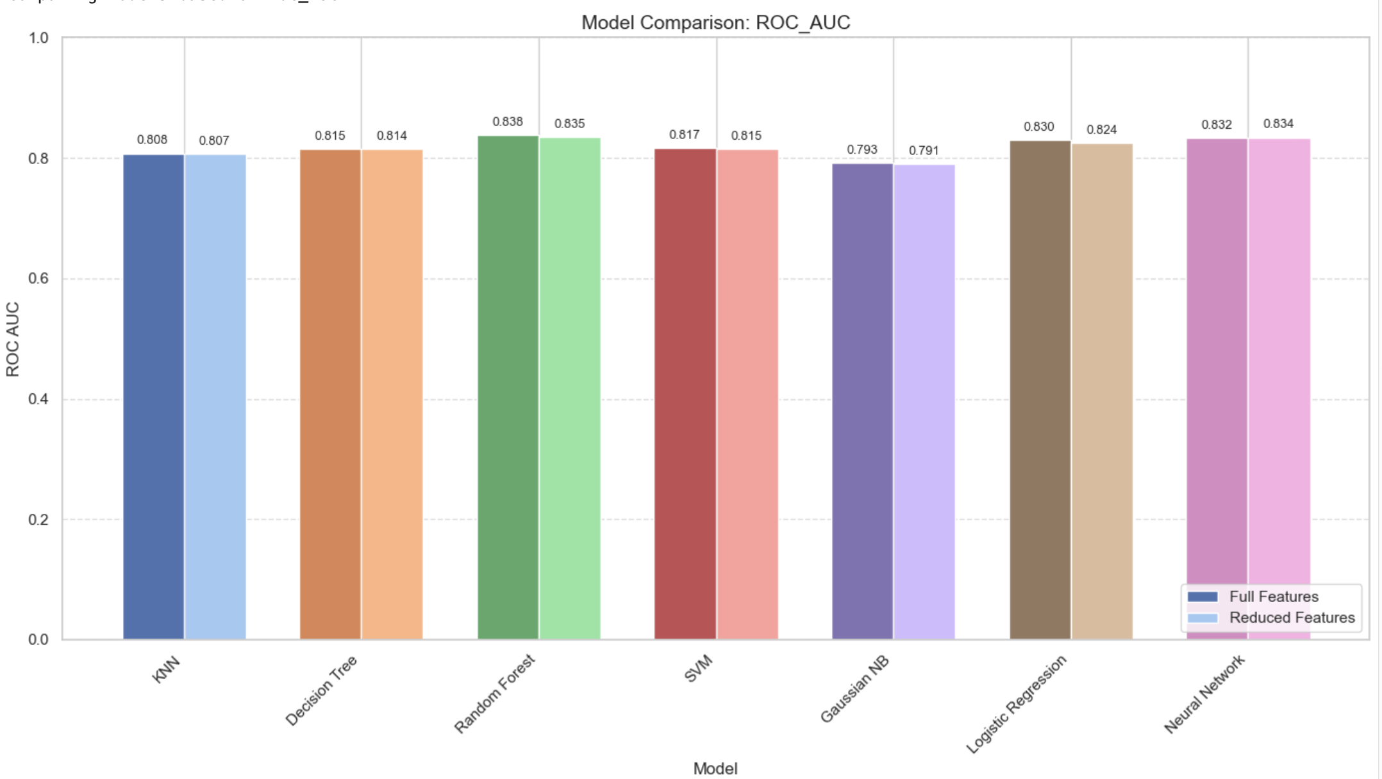
MODEL COMPARISON - ROC AUC & FEATURE IMPACT
ROC AUC Comparison:
Random Forest (Full): 0.838 [Highest]
Neural Network (Reduced): 0.834
Neural Network (Full): 0.832
Logistic Regression (Full): 0.830
Logistic Regression (Reduced): 0.824
Average Performance Change with Reduced Features:
Decision Tree: -2.35%
Logistic Regression: -0.58%
Random Forest: -0.47%
KNN: +0.31%
Neural Network: +0.15%
SVM: +1.13%
Naive Bayes: +1.66%

Slide 32
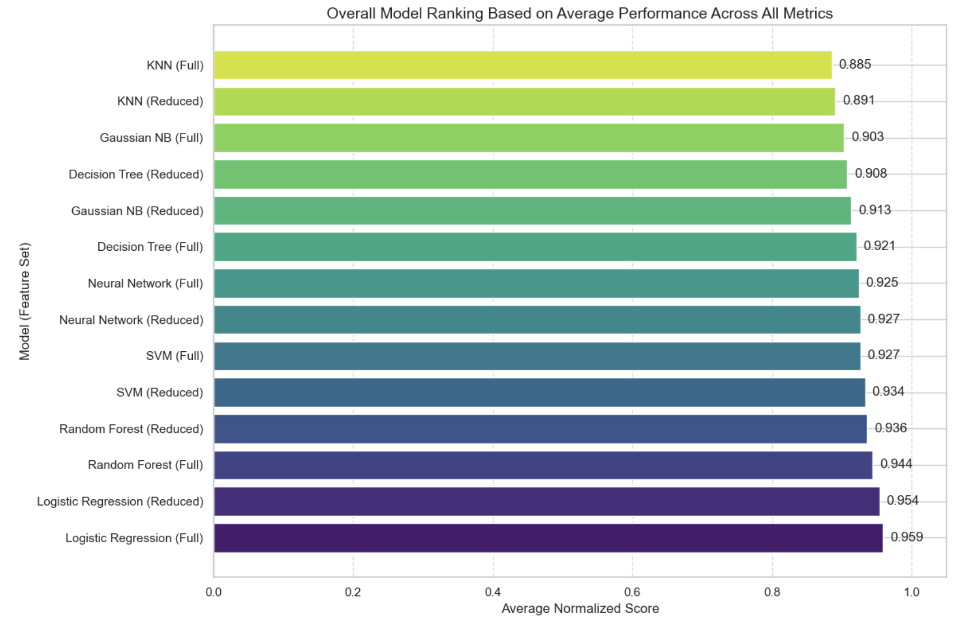
OVERALL MODEL RANKING
Normalized Score Ranking (Across All Metrics):
Logistic Regression (Full): 0.959
Logistic Regression (Reduced): 0.954
Random Forest (Full): 0.944
Random Forest (Reduced): 0.936
SVM (Reduced): 0.934
SVM (Full): 0.927
Neural Network (Reduced): 0.927
Neural Network (Full): 0.925
Key Observations:
Logistic Regression provides best overall performance
Random Forest ranked second overall
Top models maintain strong performance with reduced features
Feature reduction viable with minimal performance loss
Simple models (Logistic Regression) outperform more complex ones

Slide 33
CONCLUSIONS AND RECOMMENDATIONS
Key Findings:
Logistic Regression provides best overall performance (highest F1-score and recall)
Neural Networks offer highest precision
Random Forest achieves highest accuracy and ROC AUC
15 key features capture most predictive information
Most Important Predictors:
Gender
Liver enzymes (GTP, ALT)
Hemoglobin
Height and triglyceride levels
Recommendations:
For balanced performance: Logistic Regression
For minimizing false positives: Neural Network
For highest discrimination ability: Random Forest
Reduced feature set (15 features) viable for most applications

Slide 34
FUTURE WORK
Explore ensemble methods combining strengths of different models
Implement advanced hyperparameter tuning techniques
Test more complex neural network architectures
Validate on external datasets to ensure generalizability
Develop a clinically-applicable prediction tool
Investigate additional biological indicators potentially linked to smoking
Explore interpretability techniques for complex models
Extend model to predict smoking intensity (e.g., light vs. heavy smokers)

Slide 35
REFERENCES
Body Signal of Smoking Dataset: https://www.kaggle.com/datasets/kukuroo3/body-signal-of-smoking/data
Scikit-learn Documentation: https://scikit-learn.org/stable/
Pandas Documentation: https://pandas.pydata.org/docs/
Matplotlib & Seaborn: https://matplotlib.org/ & https://seaborn.pydata.org/
NumPy Documentation: https://numpy.org/doc/
ydata-profiling: https://github.com/ydataai/ydata-profiling

Slide 37
ANY QUESTIONS?

